Slide 1
What do I Need to Know About Systematic Screening?
Kathleen Lynne Lane, Ph.D., BCBA-D, CF-L1, Mark M. Buckman, Ph.D.
University of Kansas
Wendy Peia Oakes, Ph.D.
Arizona State University
Rebecca Sherod, MSE, & Katie S. Austin, M.Ed.
University of Kansas

Slide 2
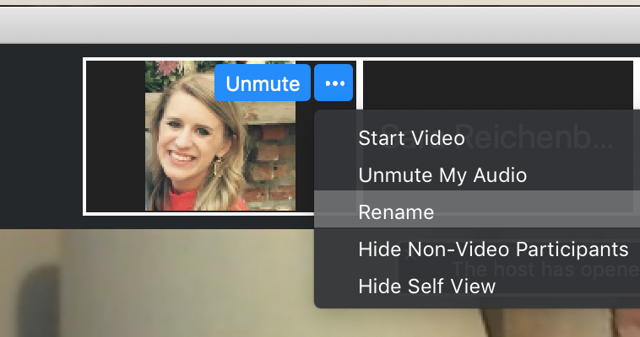
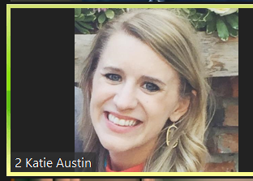
Renaming: Breakout room number + First and Last Name
To help us initially put you in breakout rooms today…
Click the three dots at the top right corner of your video square.
Rename yourself: 1 Name = Exploring screening, not yet screening 2 Name = Newly screening 3 Name = Experienced in screening 4 School Name = Here with my Ci3T Leadership Team
Notes:
https://support.zoom.us/hc/en-us/articles/115005769646 (scroll to self-selecting breakout room)

Slide 3
ci3t.org

Slide 4
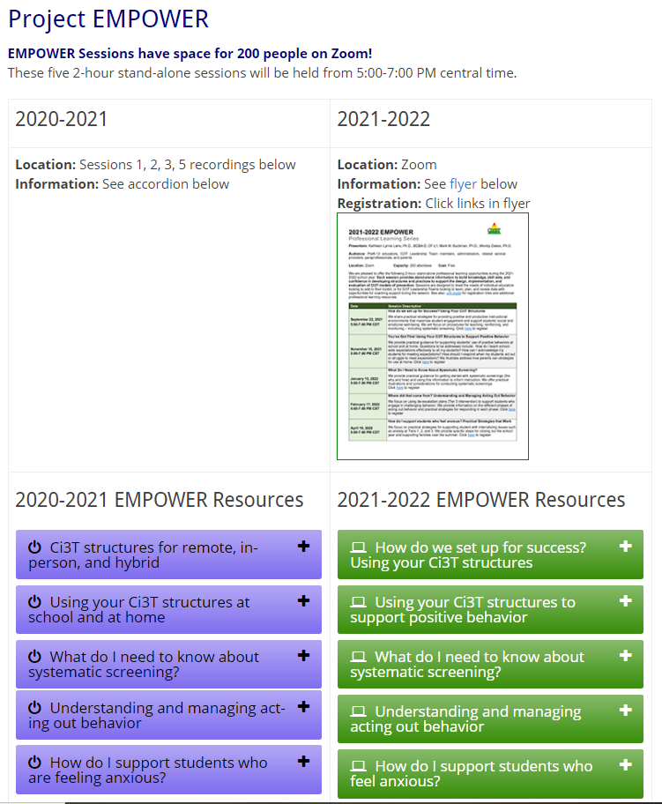
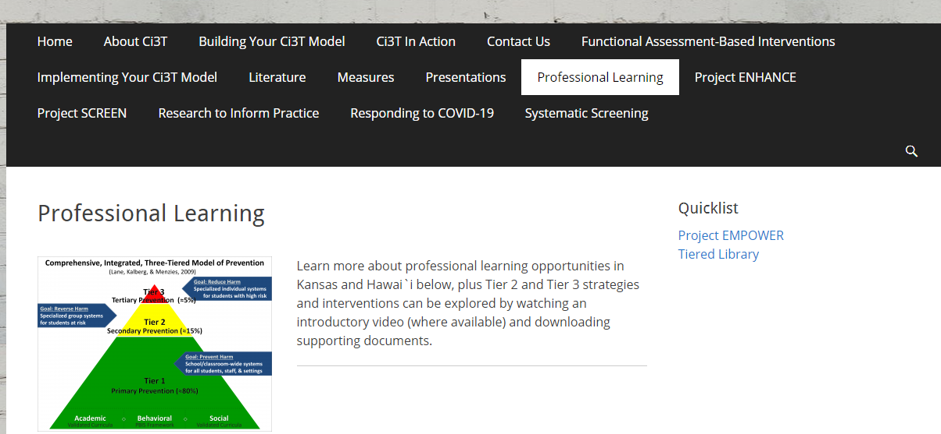
Accessing Project EMPOWER Professional Learning

Slide 5
Agenda
Introducing Ci3T… a Comprehensive, Integrated, Three-Tiered Model of Prevention
The Role of Screening: Using Screening Data to Shape Instruction
At Tier 1: Primary Preventions Efforts
At all Tiers: Teacher-delivered Strategies
At Tiers 2 & 3: Secondary & Tertiary Prevention Efforts
Planning for Next Steps

Slide 6
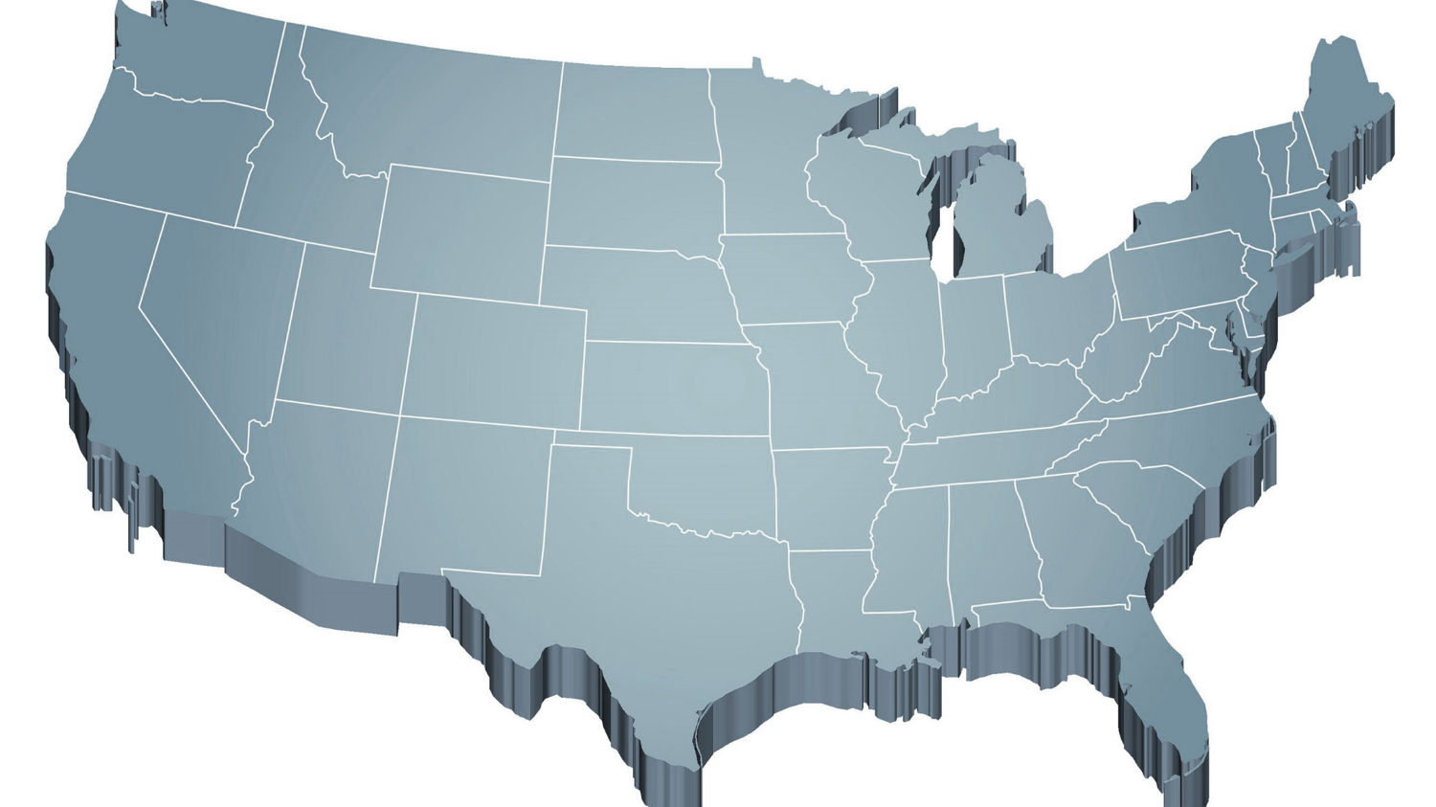
Thank you… For Your Commitment
Internalizing
Externalizing
ED <1%
EBD 12-20%
Source: Forness, S.R., Freeman, S.F., Paparella, T., Kauffman, J.M., & Walker, H.M. (2012). Special education implications of point and cumulative prevalence for children with emotional or behavioral disorders. Journal of Emotional and Behavioral Disorders, 20, 4-18.

Slide 7
Agenda
Introducing Ci3T… a Comprehensive, Integrated, Three-Tiered Model of Prevention
The Role of Screening: Using Screening Data to Shape Instruction
At Tier 1: Primary Preventions Efforts
At all Tiers: Teacher-delivered Strategies
At Tiers 2 & 3: Secondary & Tertiary Prevention Efforts
Planning for Next Steps

Slide 8
Comprehensive, Integrated, Three-Tiered Model of Prevention
(Lane, Kalberg, & Menzies, 2009)
Tier 3
Tertiary Prevention (≈5%)
Tier 2
Secondary Prevention (≈15%)
Tier 1
Primary Prevention (≈80%)
Academic ◇ Behavioral ◇ Social
Validated Curricula PBIS Framework Validated Curricula

Slide 9
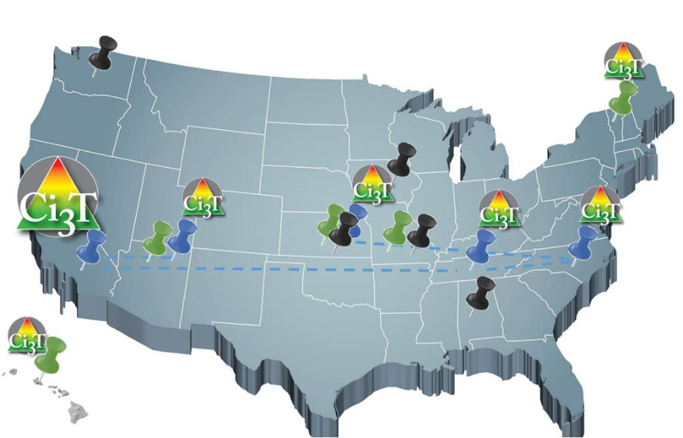
Implementing Ci3T Models: A Respectful Partnership

Slide 10
Comprehensive, Integrated, Three-Tiered Model of Prevention
(Lane, Kalberg, & Menzies, 2009)
Tier 3
Tertiary Prevention (≈5%)
Tier 2
Secondary Prevention (≈15%)
District & State Standards
High Quality Instruction
Tier 1
Primary Prevention (≈80%)
Academic ◇ Behavioral ◇ Social
Validated Curricula PBIS Framework Validated Curricula

Slide 11
Comprehensive, Integrated, Three-Tiered Model of Prevention
(Lane, Kalberg, & Menzies, 2009)
Tier 3
Tertiary Prevention (≈5%)
Tier 2
Secondary Prevention (≈15%)
Positive Behavior Interventions and Supports (PBIS)
Tier 1
Primary Prevention (≈80%)
Academic ◇ Behavioral ◇ Social
Validated Curricula PBIS Framework Validated Curricula

Slide 12
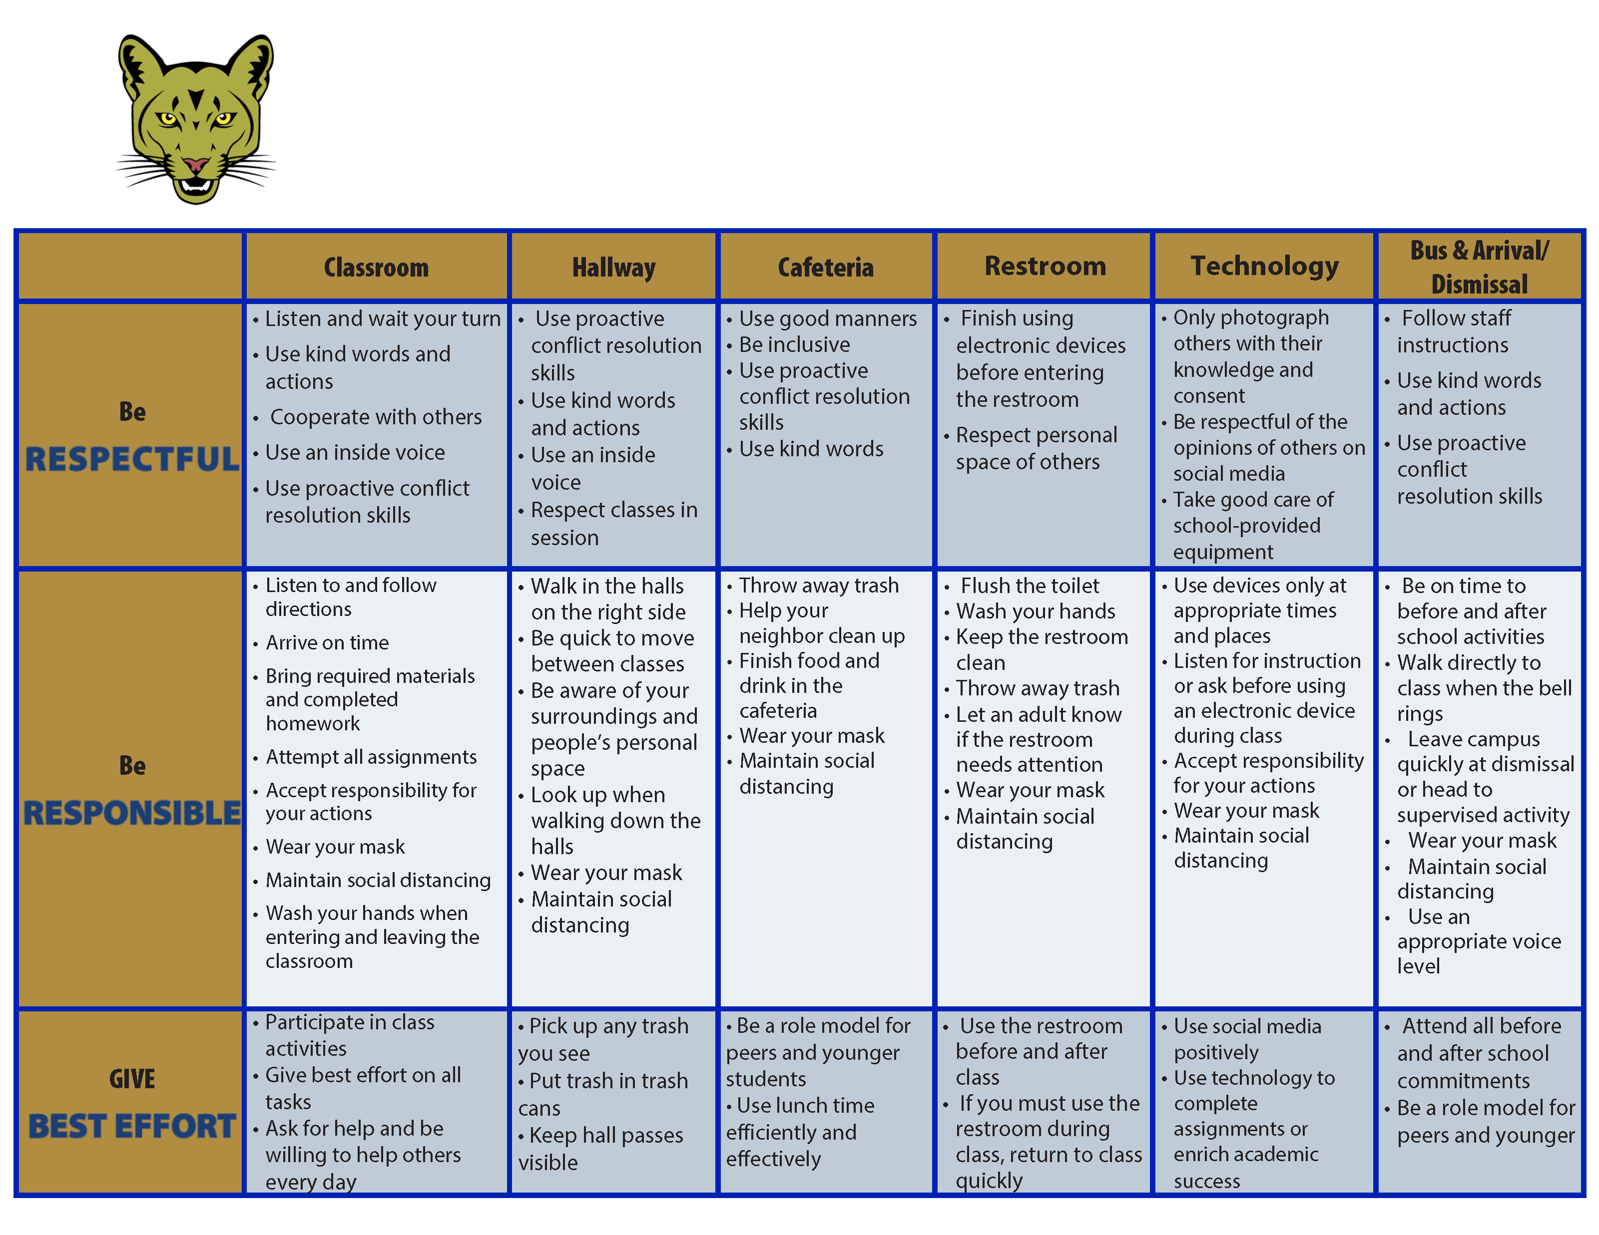
Coolidge Middle School
Expectation Matrix
Establish, Clarify, Define Expectations

Slide 13
Comprehensive, Integrated, Three-Tiered Model of Prevention
(Lane, Kalberg, & Menzies, 2009)
Tier 3
Tertiary Prevention (≈5%)
Tier 2
Secondary Prevention (≈15%)
Positive Action
Tier 1
Primary Prevention (≈80%)
Academic ◇ Behavioral ◇ Social
Validated Curricula PBIS Framework Validated Curricula

Slide 14
The Five Social and Emotional Learning Core Competencies
Self-awareness
Responsible Decision making
Relationship Skills
Social Awareness
Self-management
Social & Emotional Learning
(CASEL, 2020)

Slide 15
Social Component: Examples of Schoolwide Programs
Social-emotional
Connect With Kids connectwithkids.com
Character Education
A curricula using real stories presented through documentary-style videos, non-fiction books, teaching guides and patent resources.
Attendance and achievement
Bullying and violence prevention
Character and Life skills
Digital citizenship
Alcohol and drug prevention
Health and Wellness
Customizable units are:
Positive Action www.positiveaction.net
Improves academics, behavior, and character
Curriculum-based approach
Effectively increases positive behaviors and decreases negative behaviors
6-7 units per grade
Optional components:
site-wide climate development
drug education
bullying / conflict resolution
counselor, parent, and family classes
community/coalition components

Slide 16
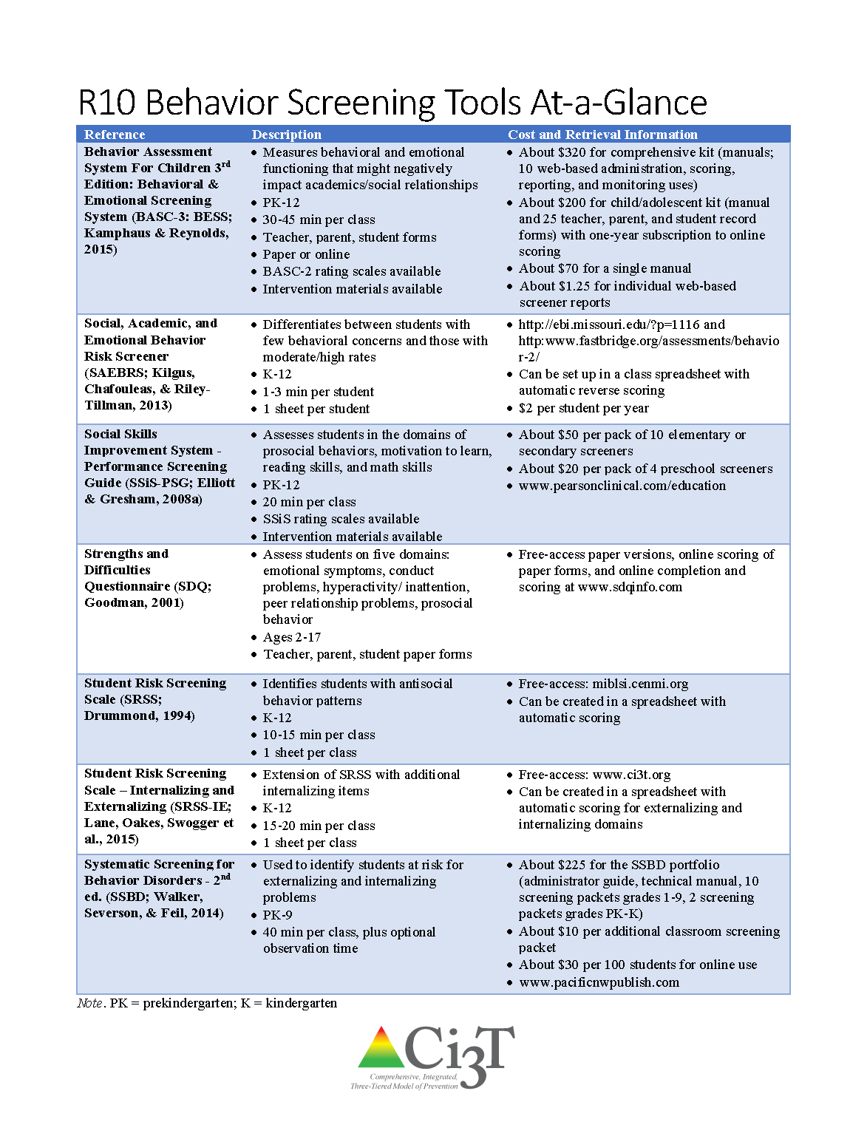

Slide 17
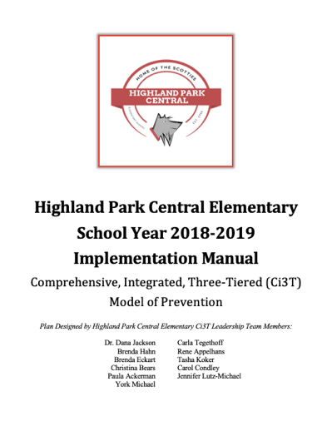
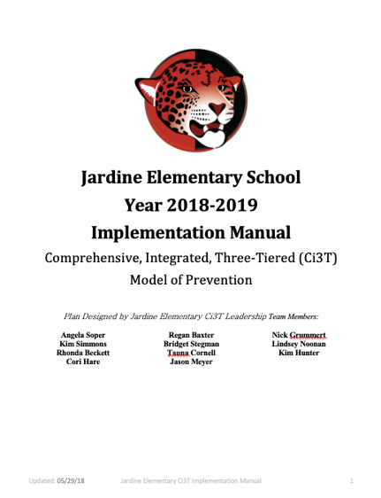
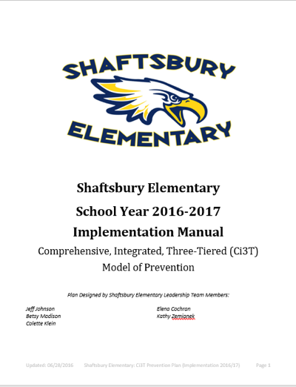
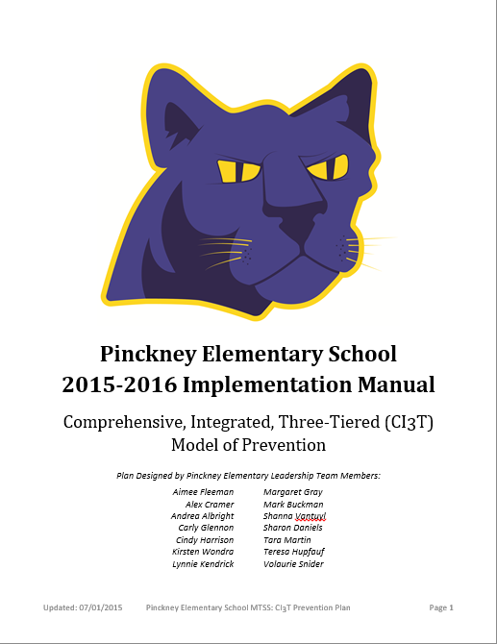
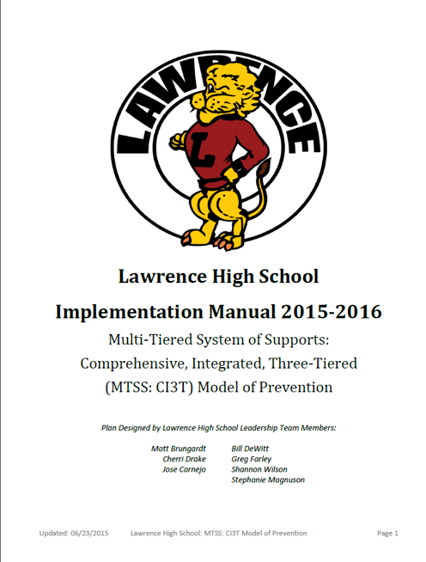
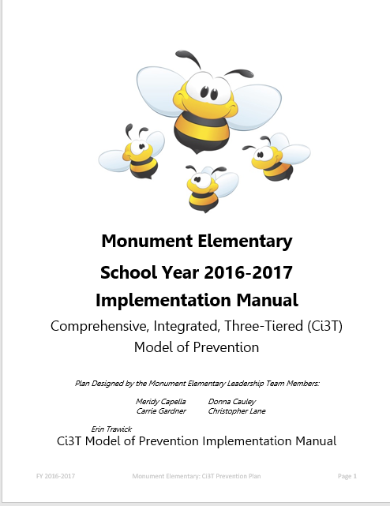
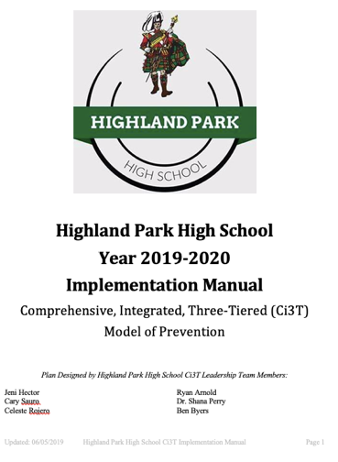

Slide 18
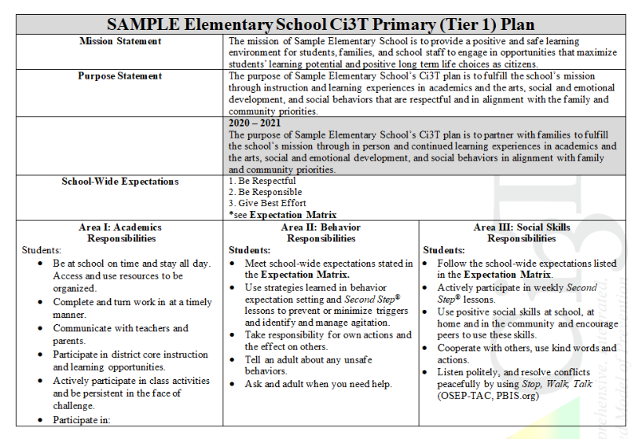

Slide 19
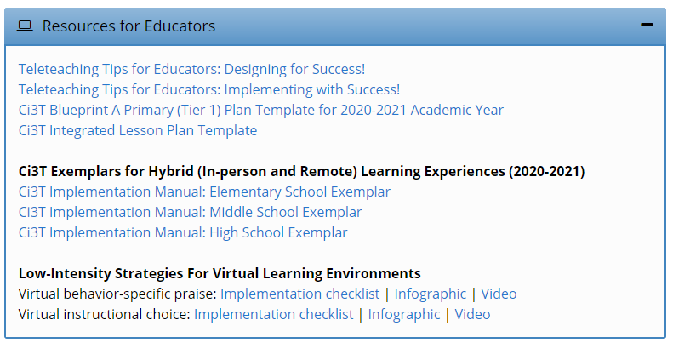
Opportunities to Respond
Area II: Academics Responsibilities Faculty and Staff: Teach core programs according to district and state standards with integrity: Use proactive evidence-based strategies to support students’ active engagement
Behavior-Specific Praise
Active Supervision
Opportunities to Respond
Instructional Feedback
High p Requests
Behavior-Specific Praise
Precorrection
Active Supervision
Remote Learning Use proactive evidence-based strategies to support students’ active engagement. Maintain online classroom platforms with learning activities connected to the weekly learning outcomes. Communicate at least weekly with families and students.
Incorporating Choice
Instructional Feedback
High-p Requests
Precorrection
Incorporating Choice

Slide 20
Area II: Behavior Responsibilities Faculty and Staff: Implement Positive Behavioral Interventions and Supports (PBIS) with integrity. Teach all setting Expectations within the first week of school and reteach Expectations (monthly). Display and model school-wide expectations in classrooms and other key settings.
Remote Learning Teach Expectations for remote learning. Set clear Expectations for your students’ learning times allowing for flexibility for unique family needs.

Slide 21
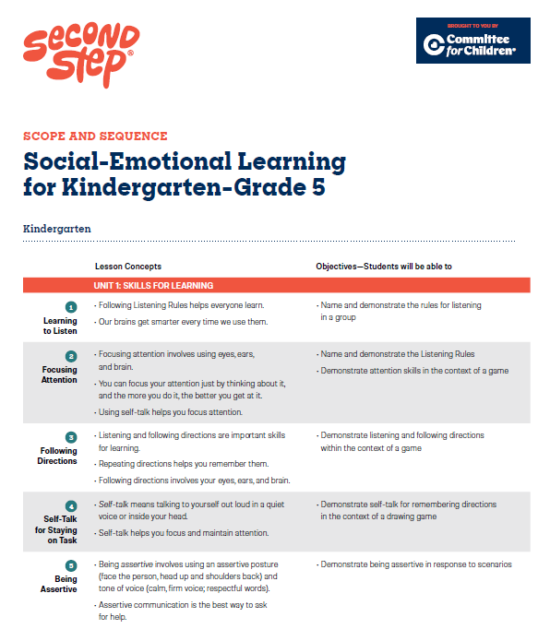
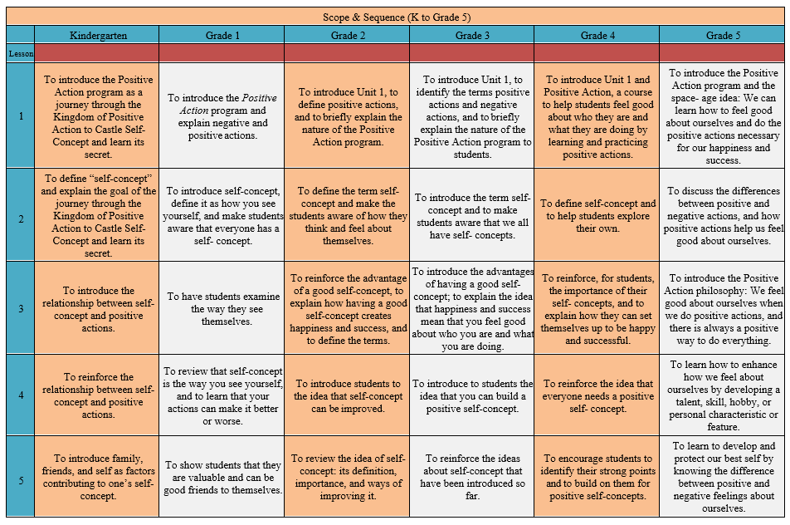
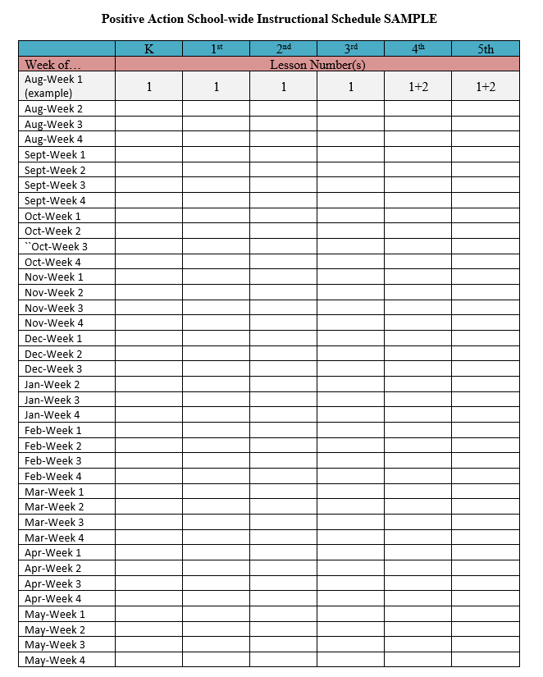
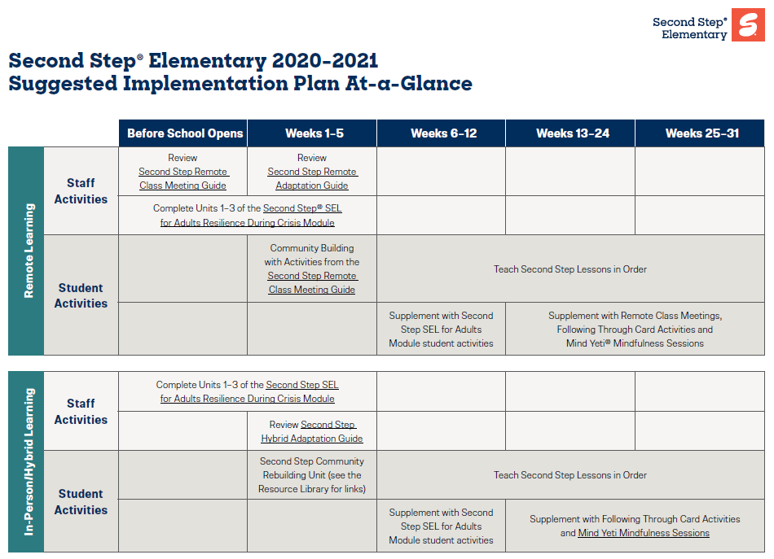
Area II: Social Responsibilities Faculty and Staff: Teach schoolwide social skills/ character education curricula with integrity: Teach daily Second Step® lessons (link to grade level instructional schedules) Seek ways to engage parents as partners in the school program
Remote Learning Begin each lesson with a connection to the social skills needed to fully engage in the lesson. Utilize online Second Step® resources to continue regular social skill lessons with asynchronous activities as well as synchronous lessons.

Slide 22
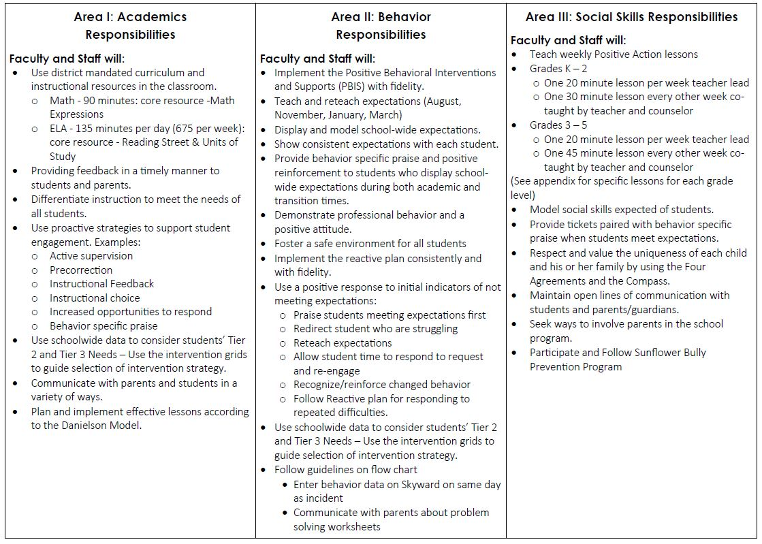
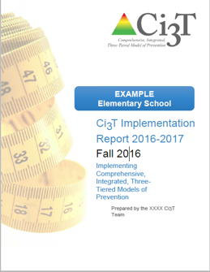
Ci3T Primary Plan: Procedures for Teaching
Ci3T Primary Plan: Procedures for Reinforcing
Ci3T Primary Plan: Procedures for Monitoring

Slide 23
Procedures for Teaching
Faculty and Staff: Ci3T Leadership Teams and District Leaders will teach procedures to faculty and staff by: Provide faculty and staff Ci3T Implementation Manual and other materials such as posters, lesson plans, tickets, etc. to teach, implement and support our Ci3T plan Provide training of plan and expectation to staff at the beginning of each school year, with attention to academic, behavior, and social domains Expectation Matrix taught and posted Ci3T session for new staff orientation Weekly tips for teachers and challenges for PBIS
Students: Ci3T Leadership Teams collaborate with faculty and staff to teach procedures to students by: Posting Ci3T expectation posters and using them as an instructional tool for teaching expectations Participating in regularly scheduled lessons on the expectations for each setting Providing behavior-specific praise intermittently paired with school-wide tickets (ROAR Bucks) Participating actively in daily Second Step lesson

Slide 24
A look at Procedures for Teaching at Tier 1
Procedures for Teaching
Faculty and Staff: Ci3T Leadership Teams and District Leaders will teach procedures to faculty and staff by: Provide faculty and staff Ci3T Implementation Manual and other materials such as posters, lesson plans, tickets, etc. to teach, implement and support our Ci3T plan. Professional learning opportunities at the district level to support implementation and sustainability of Ci3T, with attention to academic, behavior, and social domains. Expectations Matrix taught and posted. Ongoing re-teaching of expectations and procedures – dedicated staff meeting time for discussions.
Continued Learning: Ci3T Leadership Teams and District Leaders will teach procedures to faculty and staff by: Providing faculty and staff materials for remote access to the Ci3T Implementation Manual, digital ‘posters’ and e-tickets. Professional learning sessions and access guides for online materials for teaching social skills lessons. Beginning of year online meeting small-group breakout rooms for faculty and staff to review Ci3T Implementation Manual updates, get questions answered, and share ideas
Ci3T Primary Plan: Procedures for Teaching

Slide 25
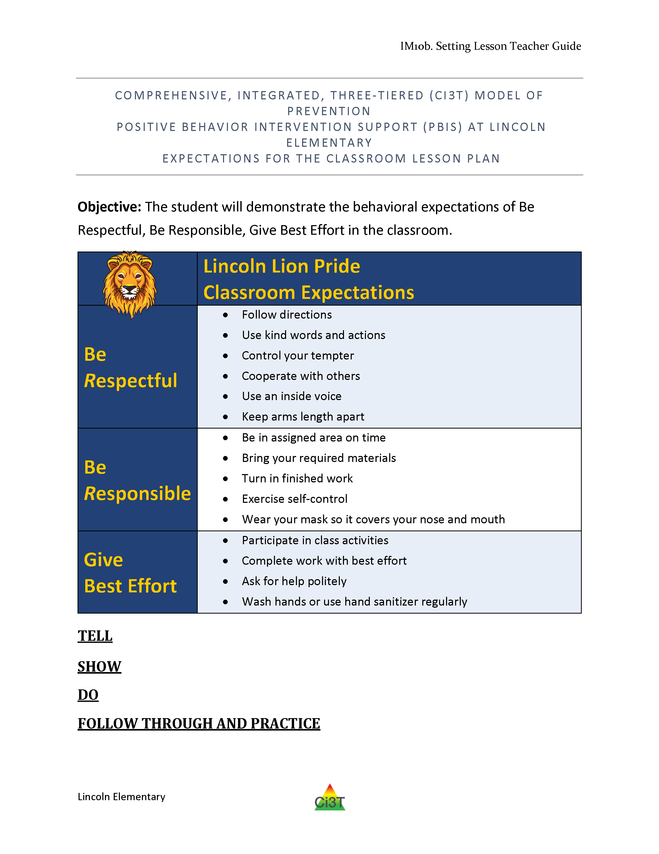
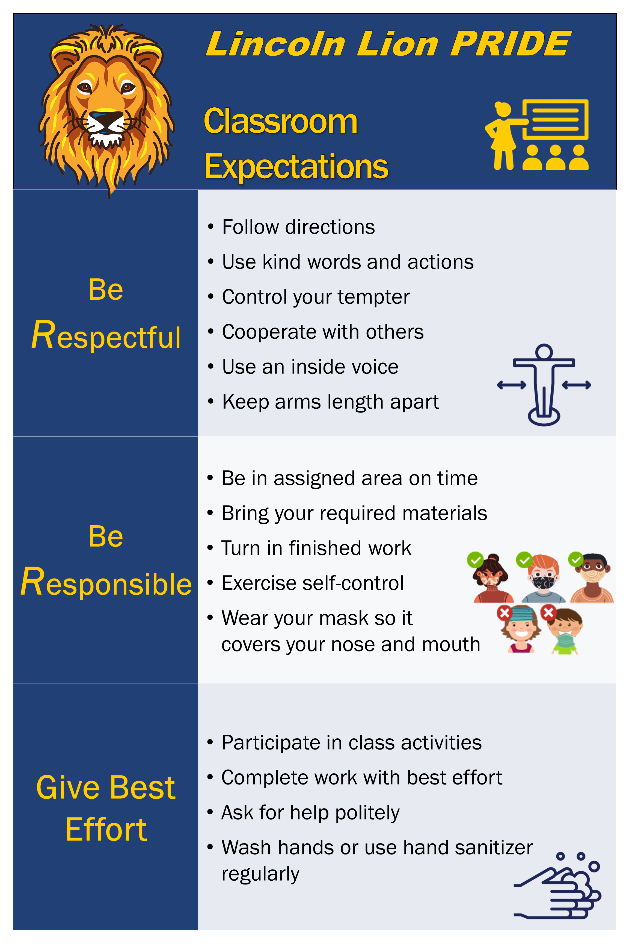
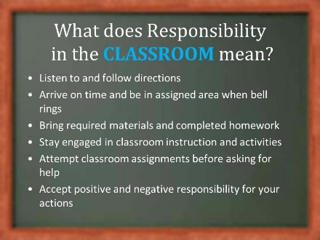
School-wide expectation matrix
Lesson plans for explicit instruction
Supporting materials
Specific setting posters
Notes:
Annotation interaction: Put a stamp on each thing your school has that you’ve seen, used, or know how to access.

Slide 26
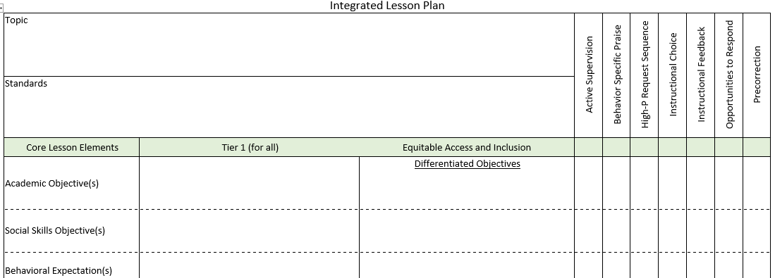
Ci3T Primary Plan: Procedures for Teaching
BSP
OTR
Active Supervision
Choice
Precorrection

Slide 27
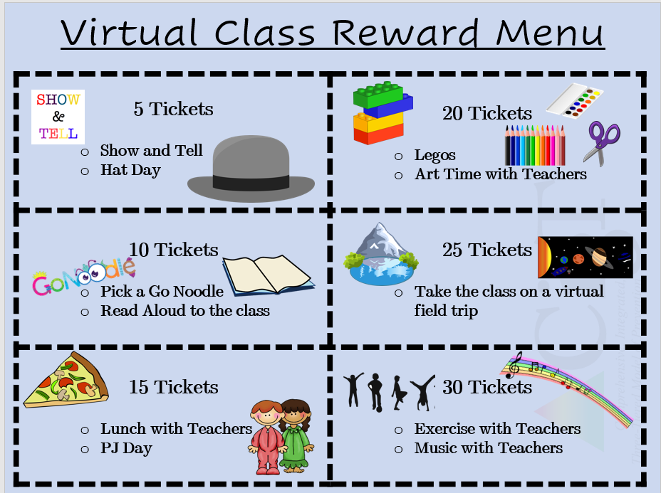
Virtual Learning Incentives
FREE Incentives:
Stay after on ZOOM with a friend for a chat
Virtual lunch date with the teacher, principal, etc. (check with that staff member before offering them up of course)
Teacher wears stickers or has a sign with the student’s name
Dress up ZOOM day (hats, PJs, costumes, etc.)
Virtual Greeting Cards (sent via email)
Show & Tell Time (or some kind of star student spotlight time)
Personalized stickers in See Saw (2nd grade has been using this)
Virtual Class Reinforcement Menu
Ci3T Primary Plan: Procedures for Reinforcing
Adapted and shared with permission from a district partner

Slide 28
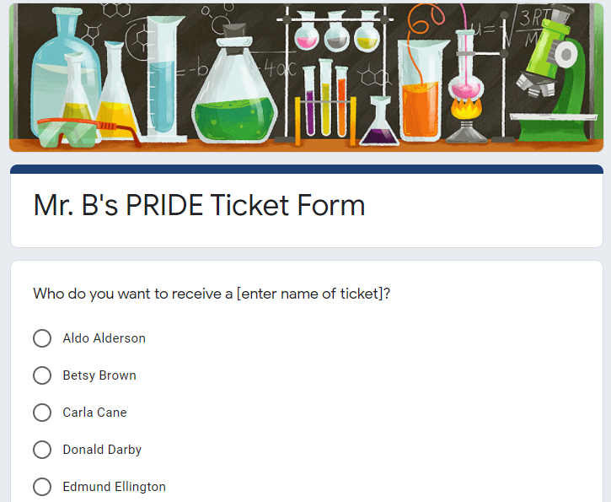
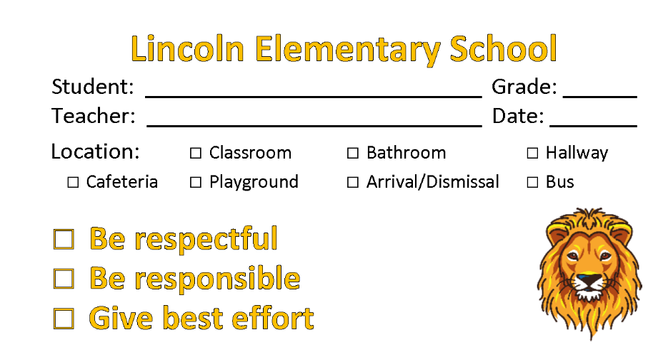
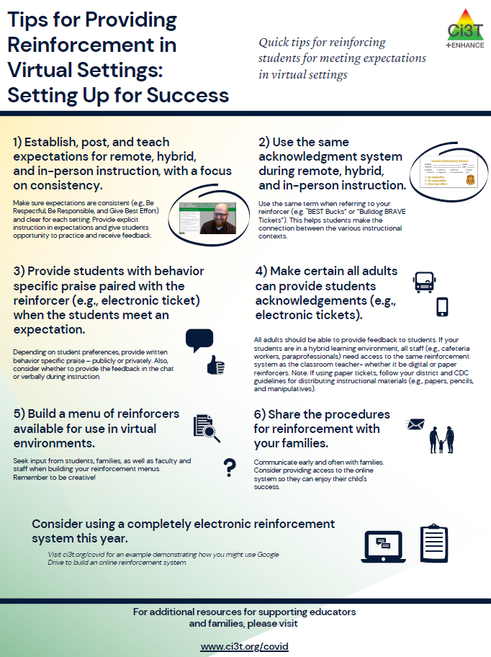
Ci3T Primary Plan: Procedures for Reinforcing

Slide 29
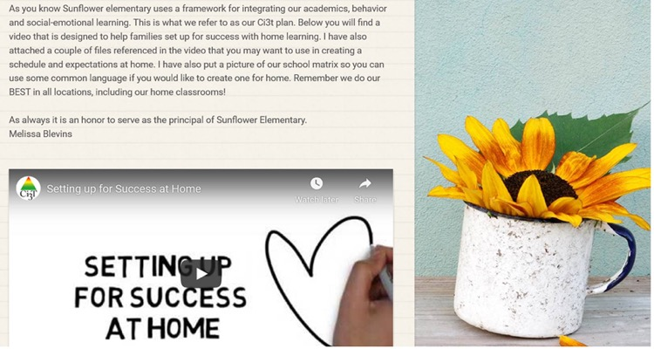
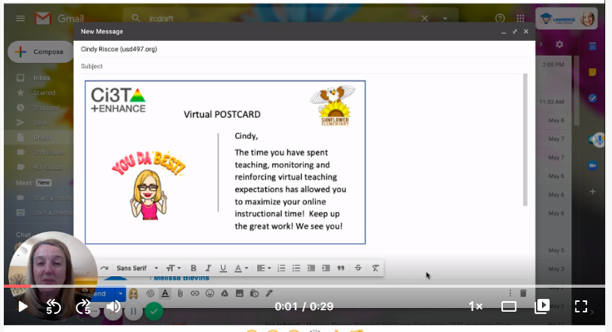
Ci3T Primary Plan: Procedures for Reinforcing

Slide 30
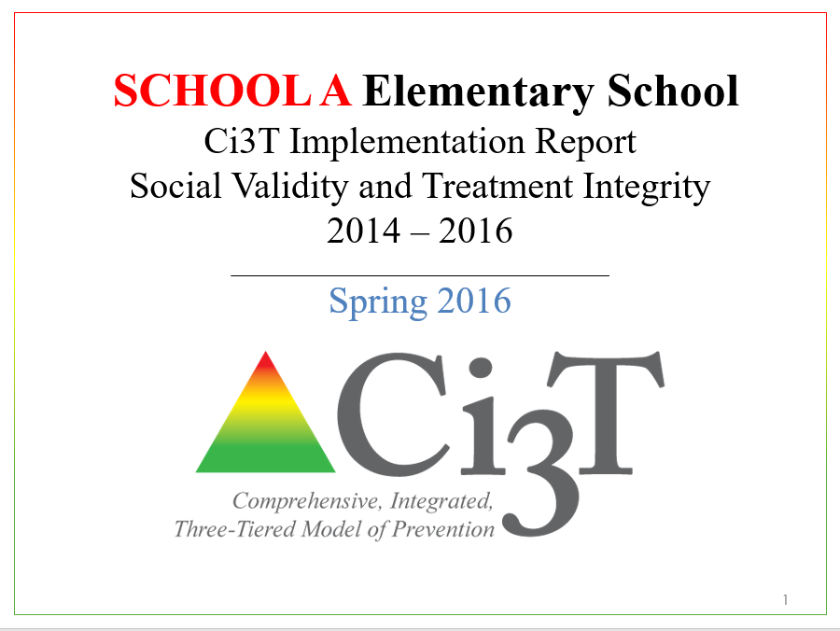
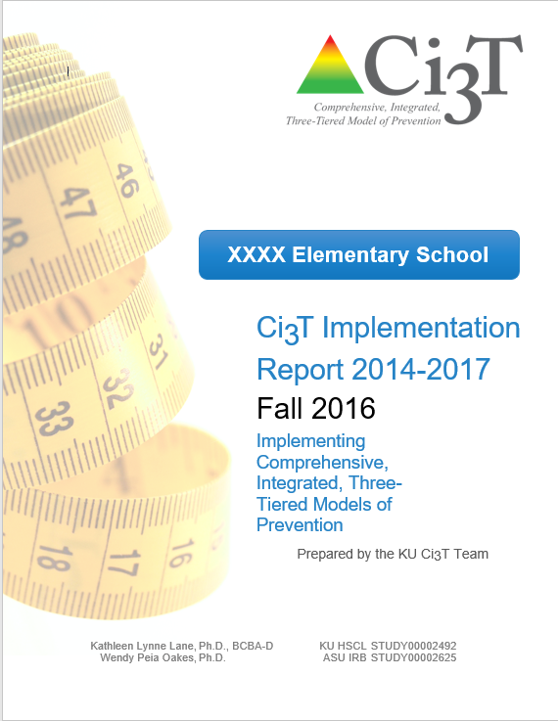
Essential Components of Primary Prevention Efforts
Social Validity
Systematic Screening
Academic
Behavior
Treatment Integrity

Slide 31
Comprehensive, Integrated, Three-Tiered Model of Prevention
(Lane, Kalberg, & Menzies, 2009)
Tier 3
Tertiary Prevention (≈5%)
Tier 2
Secondary Prevention (≈15%)
Secondary (Tier 2) Intervention Grids
Tier 1
Primary Prevention (≈80%)
Academic ◇ Behavioral ◇ Social
Validated Curricula PBIS Framework Validated Curricula

Slide 32
Comprehensive, Integrated, Three-Tiered Model of Prevention
(Lane, Kalberg, & Menzies, 2009)
Tier 3
Tertiary Prevention (≈5%)
Tier 2
Secondary Prevention (≈15%)
Tertiary (Tier 3) Intervention Grids
Tier 1
Primary Prevention (≈80%)
Academic ◇ Behavioral ◇ Social
Validated Curricula PBIS Framework Validated Curricula

Slide 33
Implementation Science Adapted from Fixsen & Blasé, 2005
Exploration & Adoption
Installation
Initial Implementation
We think we know what we need so we are planning to move forward (evidence-based)
Let’s make sure we’re ready to implement (capacity infrastructure)
Let’s give it a try & evaluate (demonstration)
Full Implementation
Let’s make it our way of doing business (institutionalized use)
Sustainability & Continuous Regeneration
That worked, let’s do it for real (investment)

Slide 34
Transparency, Access, & Collaboration
Benefits of Ci3T Models

Slide 35
When you screen… you must have a plan to intervene. What are your plans?
What structures are set up in your school or district to collect data and connect students to supports?
What are some strengths of your system?
What are some opportunities for growth?
What are your next steps – either personally or as a school – in terms of connecting students to supports?
Notes:
10-min timer

Slide 36
Agenda
Introducing Ci3T… a Comprehensive, Integrated, Three-Tiered Model of Prevention
The Role of Screening: Using Screening Data to Shape Instruction
At Tier 1: Primary Preventions Efforts
At all Tiers: Teacher-delivered Strategies
At Tiers 2 & 3: Secondary & Tertiary Prevention Efforts
Planning for Next Steps

Slide 37
Comprehensive, Integrated, Three-Tiered Model of Prevention
(Lane, Kalberg, & Menzies, 2009)
Tier 3
Tertiary Prevention (≈5%)
Tier 2
Secondary Prevention (≈15%)
Tier 1
Primary Prevention (≈80%)
Academic ◇ Behavioral ◇ Social
Validated Curricula PBIS Framework Validated Curricula

Slide 38
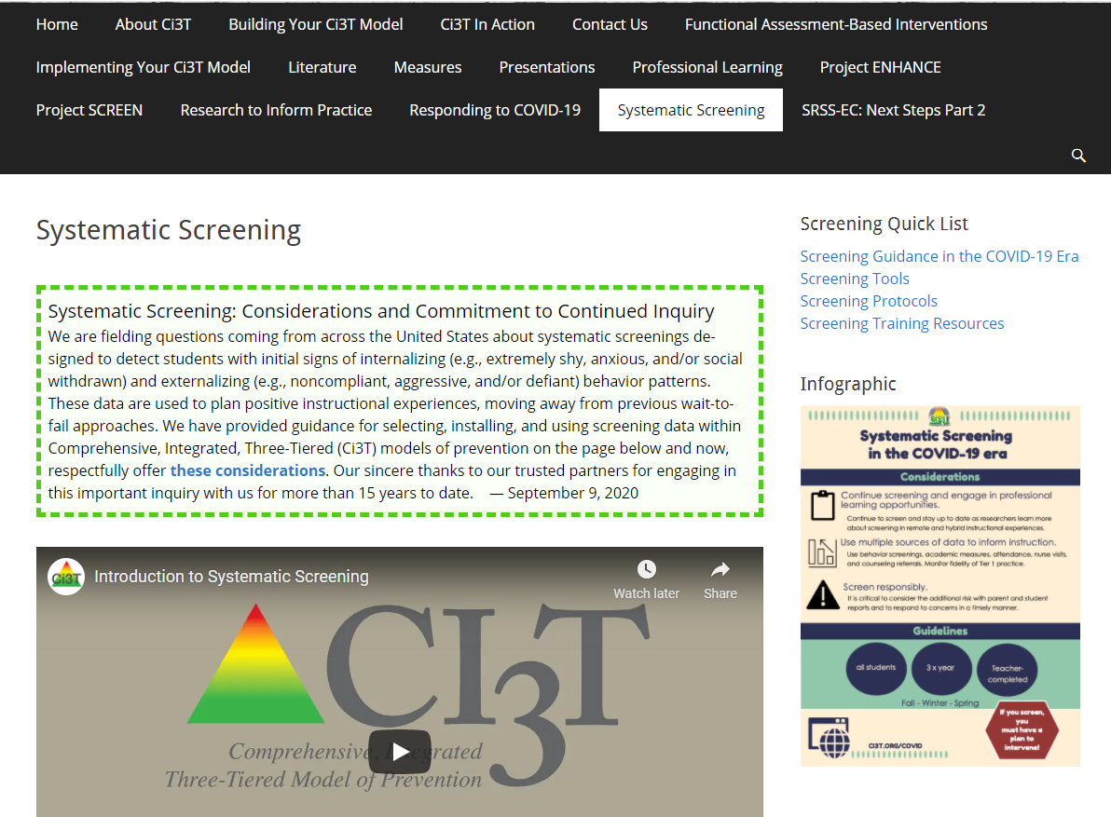
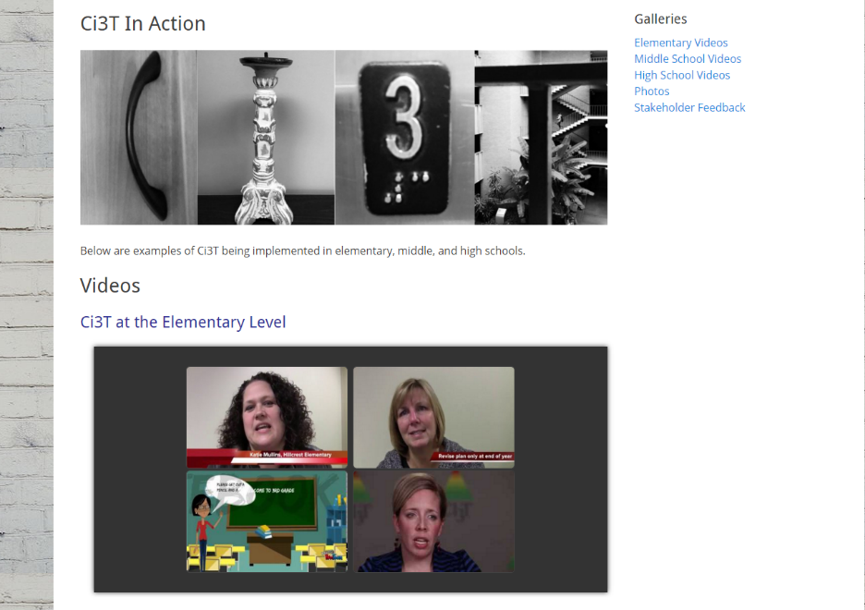
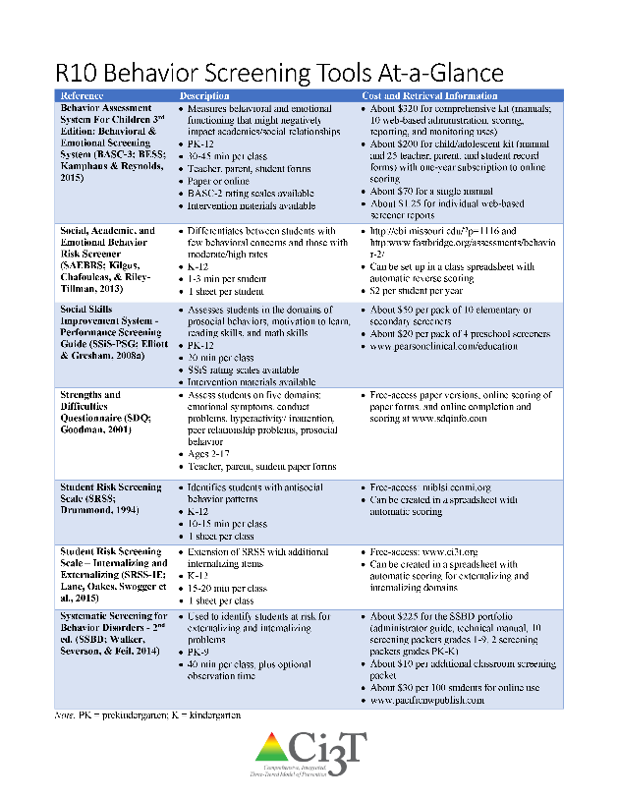
Systematic Screening
www.ci3t.org

Slide 39
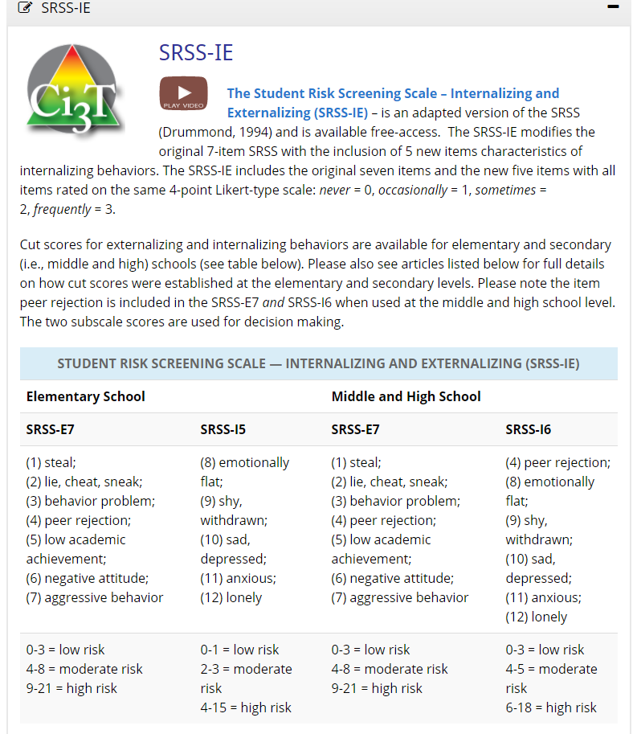
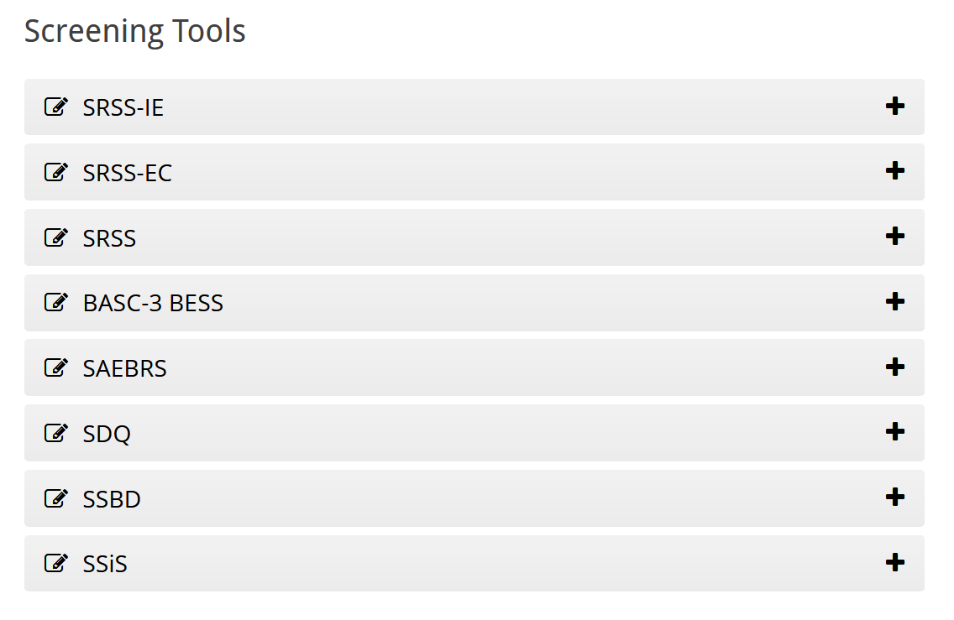

Slide 40
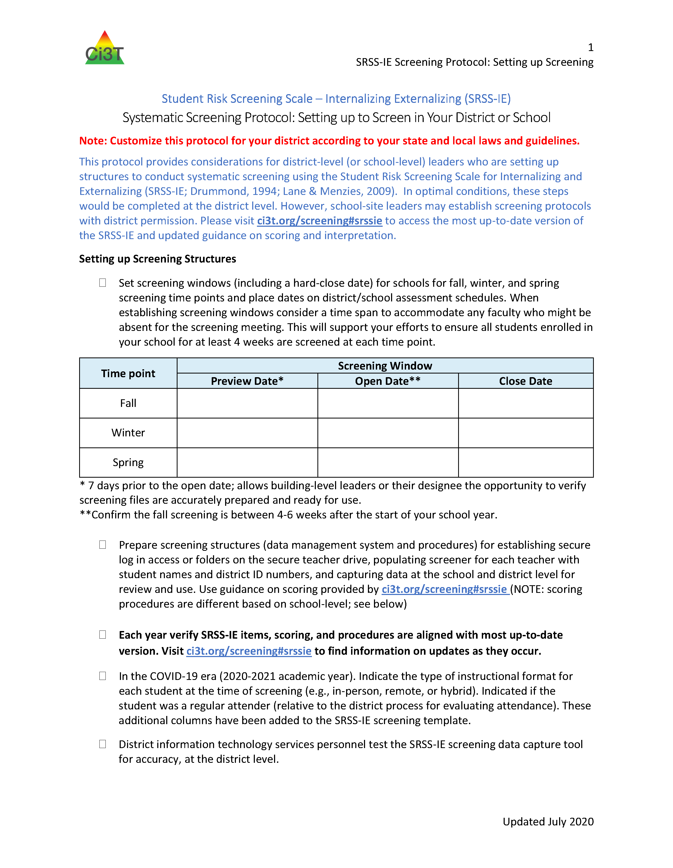
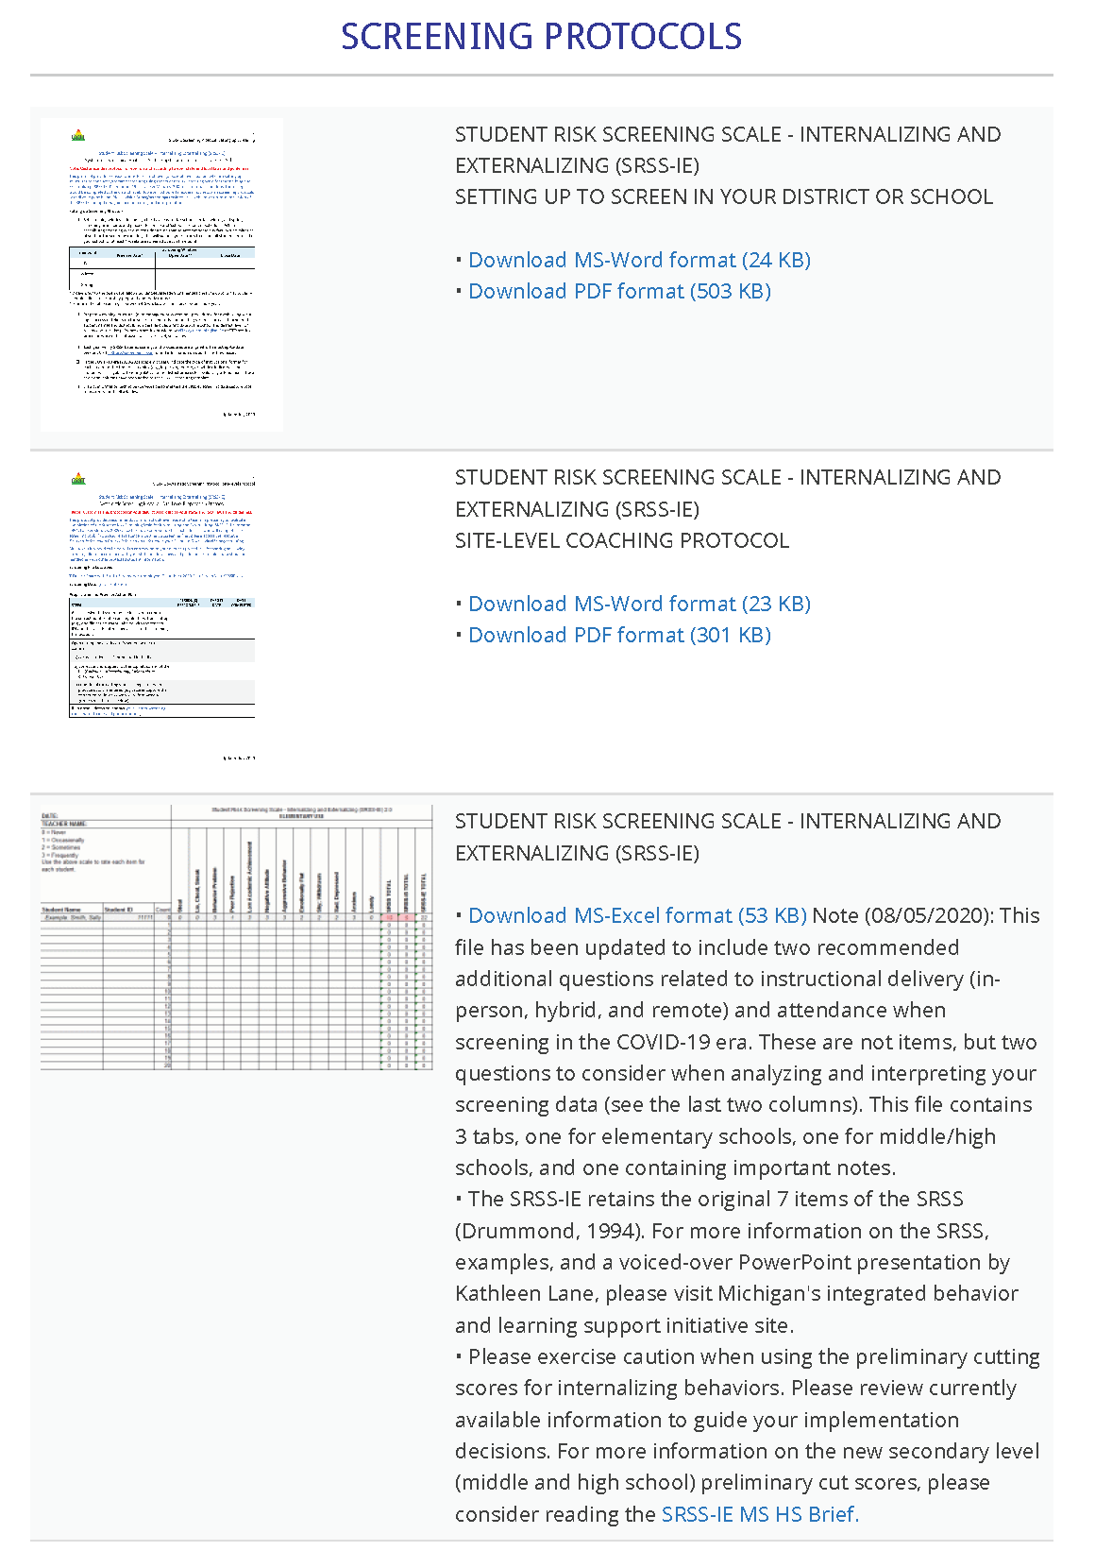
ci3t.org/screening
SRSS-IE Screening Process Reminders
Rate ACROSS the scale (one student at a time). Rate all items for each student before moving on to the next student. Rate students independently without conferencing or talking with other teachers or staff (even if you are a co-teacher). The sum columns will calculate automatically. Please do not type or click in the total columns’ cells. All students who are eligible for screening have already been pre-populated; additional students should not be added for this screening period (only students who have been in school for 30 days should be screened [about 4 weeks]). Please do rate students who have been there for at least 30 days during the screening period but have moved. You may need to scroll to the right in the spreadsheet to ensure you rate students on all items (12 items for each student). Scroll down in the spreadsheet to ensure you rate all students in your assigned class. The sum columns will calculate automatically – please do not type in the columns’ cell.

Slide 41
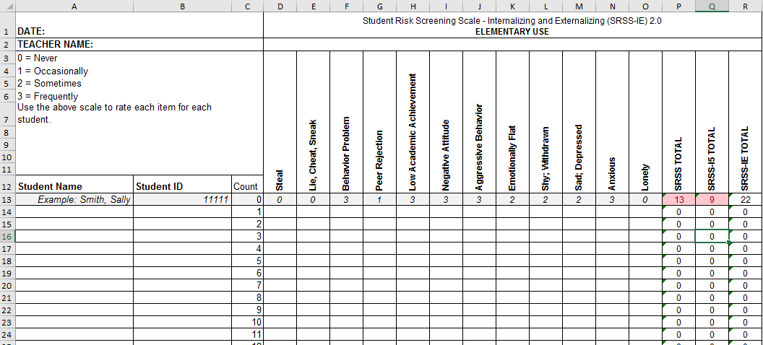
Student Risk Screening Scale for Internalizing and Externalizing (SRSS-IE; Drummond, 1994; Lane & Menzies, 2009) for Elementary Schools

Slide 42
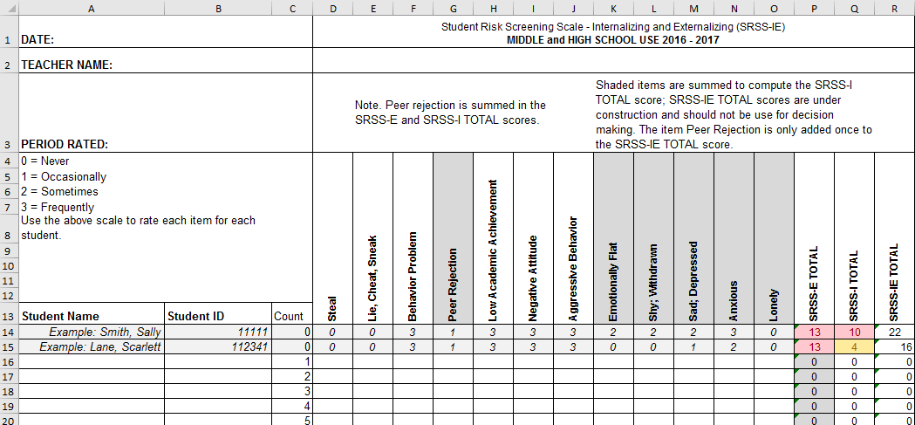
Student Risk Screening Scale for Internalizing and Externalizing (SRSS-IE; Drummond, 1994; Lane & Menzies, 2009) for Secondary Schools

Slide 43
SRSS-IE: Cut Scores
Elementary School |  | Middle and High School
SRSS-E7 | SRSS-I5 | SRSS-E7 | SRSS-I6
Items 1-7 | Items 8-12 | Items 1-7 | Items 4, 8-12
0-3 = low risk 4-8 = moderate risk 9-21 = high risk | 0-1 = low risk 2-3 = moderate risk 4-15 = high risk | 0-3 = low risk 4-8 = moderate risk 9-21 = high risk | 0-3 = low risk 4-5 = moderate risk 6-18 = high risk
Elementary School Level:
Lane, K. L., Oakes, W. P., Swogger, E. D., Schatschneider, C., Menzies, H., M., & Sanchez, J. (2015). Student risk screening scale for internalizing and externalizing behaviors: Preliminary cut scores to support data-informed decision making. Behavioral Disorders, 40, 159-170.
Middle and High School Levels:
Lane, K. L., Oakes, W. P., Cantwell, E. D., Schatschneider, C., Menzies, H., Crittenden, M., & Messenger, M. (2016). Student Risk Screening Scale for Internalizing and Externalizing Behaviors: Preliminary cut scores to support data-informed decision making in middle and high schools. Behavioral Disorders, 42(1), 271-284

Slide 44
Fall 2021 SRSS-Externalizing Results – School level
n = 34
n = 40
n = 33
n = 10
n = 19
n = 35
n = 34
n = 35
n = 41
n = 52
n = 42
n = 26
n = 35
n = 52
n = 52
n = 61
n = 153
n = 135
n = 127
n = 146
n = 137
n = 109
n = 91
n = 135
Notes:
Fill in <year> based on current academic year. This is located in column A of the data sheet. Edit by right clicking and selecting “Edit data”.
Our school partners still wanted to screen- information was important

Slide 45
Fall 2021 SRSS-Internalizing Results – School level
n = 31
n = 42
n = 39
n = 49
n = 18
n = 26
n = 61
n = 46
n = 44
n = 37
n = 35
n = 46
n = 27
n = 31
n = 38
n = 30
n = 153
n = 148
n = 128
n = 136
n = 137
n = 134
n = 97
n = 101
Cut scores vary by school level:
Elementary (I5): Low (0-1), Moderate (2-3), High (4-15)
Middle and High (I6): Low (0-3), Moderate (4-5), High (6-18)
Notes:
Fill in <year> based on current academic year. This is located in column A of the data sheet. Edit by right clicking and selecting “Edit data”.
IMPORTANT NOTE: The INTERNALIZING subscale and CUT SCORES are specific to school level.
Elementary: SRSS-I5, Items 8-12, 0-1 = low risk, 2-3 = moderate risk, 4-15 = high risk
Middle and High: SRSS-I6, Items 4, 8-12, 0-3 = low risk, 4-5 = moderate risk, 6-18 = high risk

Slide 46
Fall 2020 SRSS-Externalizing Results – Elementary
Grade Level | N Screened | Low n (%) | Moderate n (%) | High n (%)
K | 69 | 65 (94.20%) | 3 (4.35%) | 1 (1.45%)
1 | 47 | 44 (93.62%) | 2 (4.26%) | 1 (2.13%)
2 | 68 | 56 (82.35%) | 10 (14.71%) | 2 (2.94%)

Slide 47
Results: SRSS-IE: Externalizing Subscale Elementary
Variable | Risk |  |  | Significance Testing
 | Low M (SD) n | Moderate M (SD) n | High M (SD) n
Oral Reading Fluency | 163.23 (39.66) 468 | 138.62 (42.70) 107 | 115.82 (46.21) 46 | L > M > H
MAP Reading | 66.54 (26.48) 2,047 | 42.91 (30.37) 443 | 33.32 (29.82) 199 | L > M > H
Nurse Visits | 6.14 (6.81) 3,256 | 9.18 (9.59) 820 | 11.83 (9.89) 389 | L < M < H
In-School Suspensions | 0.0052 (0.08) 3,256 | 0.0427 (0.30) 820 | 0.1080 (0.46) 389 | L < M < H
Fall Externalizing
Winter Externalizing
Spring
ORF
MAP Reading
Nurse Visit
Suspensions
Lane, K. L., Oakes, W. P., Cantwell, E. D., Common, E. A., Royer, D. J., Leko, M. M., Schatschneider, C., Menzies, H. M., Buckman, M. M., & Allen, G. E. (2019). Predictive validity of Student Risk Screening Scale—Internalizing and Externalizing (SRSS-IE) scores in elementary schools. Journal of Emotional and Behavioral Disorders, 27(4), 221–234. https://doi.org/10.1177/1063426618795443

Slide 48
Results: SRSS-IE: Internalizing Subscale Elementary
Variable | Risk |  |  | Significance Testing
 | Low M (SD) n | Moderate M (SD) n | High M (SD) n
Oral Reading Fluency | 159.04 (41.45) 459 | 150.59 (45.76) 88 | 139.18 (46.53) 74 | L > H L = M; M = H
MAP Reading | 63.38 (28.32) 2,070 | 53.93 (32.15) 356 | 43.57 (30.47) 263 | L > M > H
Nurse Visits | 6.84 (7.37) 3,387 | 7.59 (8.05) 628 | 9.33 (10.81) 450 | L < M < H
In-School Suspensions | 0.0142 (0.15) 3,387 | 0.0510 (0.36) 628 | 0.0311 (0.20) 450 | L < M, H M = H
Fall Internalizing
Winter Internalizing
Spring
ORF*
MAP Reading
Nurse Visit
Suspensions*
Lane, K. L., Oakes, W. P., Cantwell, E. D., Common, E. A., Royer, D. J., Leko, M. M., Schatschneider, C., Menzies, H. M., Buckman, M. M., & Allen, G. E. (2019). Predictive validity of Student Risk Screening Scale—Internalizing and Externalizing (SRSS-IE) scores in elementary schools. Journal of Emotional and Behavioral Disorders, 27(4), 221–234. https://doi.org/10.1177/1063426618795443

Slide 49
Student Risk Screening Scale Fall 2004 – 2012 Middle School
Source: Lane, K. L., Oakes, W. P., & Magill, L. M., (2014). Primary prevention efforts: How do we implement and monitor the Tier 1 component of our comprehensive, integrated, three-tiered model of prevention. Preventing School Failure, 58, 143-158. doi: 10.1080/1045988X.2014.893978 [Figure 4. Middle school behavior screening data over time at the fall time point. Adapted from Figure 4.6 p. 127 Lane, K. L., Menzies, H. M, Oakes, W. P., & Kalberg, J. R. (2012). Systematic screenings of behavior to support instruction: From preschool to high school. Guilford Press.]

Slide 50
Middle School Study 1: Behavioral & Academic Characteristics of SRSS Risk Groups
Variable |  | Risk
 | Low (n = 422) M (SD) | Moderate (n = 51) M (SD) | High (n = 12) M (SD) | Significance Testing
ODR | 1.50 (2.85) | 5.02 (5.32) | 8.42 (7.01) | L<M<H
In-School Suspensions | 0.08 (0.38) | 0.35 (1.04) | 1.71 (2.26) | L<M<H
GPA | 3.35 (0.52) | 2.63 (0.65) | 2.32 (0.59) | L>M, H M=H
Course Failures | 0.68 (1.50) | 2.78 (3.46) | 4.17 (3.49) | L<M, H M=H
(Lane, Parks, Kalberg, & Carter, 2007)

Slide 51
SRSS-IE: Externalizing Subscale Middle school
Variable |  | Risk |  | Significance Testing
 | Low M (SD) n | Moderate M (SD) n | High M (SD) n
GPA | 3.56 (0.47) 1,670 | 3.07 (0.58) 279 | 2.74 (0.61) 84 | L > M > H
Course Failures | 0.38 (1.15) 1,830 | 1.37 (2.12) 328 | 2.78 (3.03) 93 | L < M < H
Nurse Visits | 4.01 (16.20) 1,830 | 6.67 (8.65) 328 | 9.66 (11.65) 93 | L < M, H M = H
Office discipline referrals | 0.03 (0.24) 1,830 | 0.17 (0.63) 328 | 0.75 (2.13) 93 | L < M < H
In-School Suspensions | 0.11 (0.89) 1,830 | 0.67 (2.74) 328 | 1.56 (3.22) 93 | L < M < H
Fall Externalizing
Winter Externalizing
Spring
GPA
Course Failures
Nurse Visit*
ODR
Suspensions
Lane, K. L., Oakes, W. P., Cantwell, E. D., Royer, D. J., Leko, M., Schatschneider, C., & Menzies, H. M. (2018). Predictive validity of Student Risk Screening Scale for Internalizing and Externalizing (SRSS-IE) scores in secondary schools. Journal of Emotional and Behavioral Disorders, 27(2), 86-100. doi:10.1177/1063426617744746

Slide 52
SRSS-IE: Internalizing Subscale Middle school
Variable |  | Risk |  | Significance Testing
 | Low M (SD) n | Moderate M (SD) n | High M (SD) n
GPA | 3.51 (0.51) 1,642 | 3.33 (0.55) 167 | 3.16 (0.64) 224 | L > M > H
Course Failures | 0.52 (1.42) 1,820 | 0.86 (1.85) 181 | 1.22 (2.06) 250 | L < M, H M = H
Nurse Visits | 4.32 (16.39) 1,820 | 4.85 (6.92) 181 | 6.77 (9.56) 250 | L < H L = M M = H
Office discipline referrals | 0.06 (0.40) 1,820 | 0.17 (1.24) 181 | 0.19 (0.75) 250 | N.S.
In-School Suspensions | 0.18 (1.10) 1,820 | 0.67 (3.59) 181 | 0.45 (1.47) 250 | L < M, H M = H
Fall Internalizing
Winter Internalizing
Spring
GPA
Course Failures*
Nurse Visit*
Suspensions*
Lane, K. L., Oakes, W. P., Cantwell, E. D., Royer, D. J., Leko, M., Schatschneider, C., & Menzies, H. M. (2018). Predictive validity of Student Risk Screening Scale for Internalizing and Externalizing (SRSS-IE) scores in secondary schools. Journal of Emotional and Behavioral Disorders, 27(2), 86-100. doi:10.1177/1063426617744746

Slide 53
Screening Data: High School Yrs1-3
Fall- SRSSIE-I |  | Low |  | Moderate |  | High |  | Fall- SRSSIE-E |  | Low |  | Moderate |  | High
2016 |  | 80.28% |  | 10.36% |  | 9.36% |  | 2016 |  | 89.56% |  | 8.02% |  | 2.42%
2017 |  | 90.18% |  | 4.16% |  | 5.66% |  | 2017 |  | 91.29% |  | 6.18% |  | 2.54%
2018 |  | 90.91% |  | 3.86% |  | 5.23% |  | 2018 |  | 92.22% |  | 6.20% |  | 1.58%
WTR-SRSSIE-I |  | Low |  | Moderate |  | High |  | WTR-SRSSIE-E |  | Low |  | Moderate |  | High
2016 |  | 87.25% |  | 9.49% |  | 3.26% |  | 2016 |  | 87.25% |  | 9.49% |  | 3.26%
2017 |  | 86.14% |  | 9.02% |  | 4.85% |  | 2017 |  | 86.14% |  | 9.02% |  | 4.85%
2018 |  | 88.79% |  | 8.52% |  | 2.69% |  | 2018 |  | 88.79% |  | 8.52% |  | 2.69%

Slide 54
SRSS-IE: Externalizing Subscale High school
Variable |  | Risk |  | Significance Testing
 | Low M (SD) n = 2,363 | Moderate M (SD) n = 212 | High M (SD) n = 59
GPA | 3.07 (0.79) | 2.08 (0.81) | 1.96 (0.89) | L > M, H M = H
Course Failures | 1.16 (2.07) | 3.45 (3.18) | 3.08 (2.84) | L < M, H M = H
Nurse Visits | 1.34 (3.19) | 4.00 (5.62) | 5.85 (7.66) | L < M, H M = H
In-School Suspensions | 0.07 (0.44) | 0.67 (1.48) | 1.03 (1.86) | L < M, H M = H
Fall Externalizing
Winter Externalizing
Spring
GPA
Course Failures
Nurse Visit
ODR
Suspensions
L < M, H
M = H
Lane, K. L., Oakes, W. P., Cantwell, E. D., Royer, D. J., Leko, M., Schatschneider, C., & Menzies, H. M. (2018). Predictive validity of Student Risk Screening Scale for Internalizing and Externalizing (SRSS-IE) scores in secondary schools. Journal of Emotional and Behavioral Disorders, 27(2), 86-100. doi:10.1177/1063426617744746

Slide 55
SRSS-IE: Internalizing Subscale High school
Variable |  | Risk |  | Significance Testing
 | Low M (SD) n = 2,379 | Moderate M (SD) n = 123 | High M (SD) n = 132
GPA | 3.04 (0.82) | 2.44 (0.83) | 2.27 (0.98) | L > M, H M = H
Course Failures | 1.25 (2.17) | 2.59 (2.66) | 2.83 (3.21) | L < M, H M = H
Nurse Visits | 1.43 (3.33) | 3.54 (6.05) | 4.04 (5.80) | L < M, H M = H
In-School Suspensions | 0.11 (0.57) | 0.41 (1.36) | 0.42 (1.28) | L < M, H M = H
Fall Internalizing
Winter Internalizing
Spring
GPA
Course Failures
Nurse Visit
ODR
Suspensions
L < M, H
M = H
Lane, K. L., Oakes, W. P., Cantwell, E. D., Royer, D. J., Leko, M., Schatschneider, C., & Menzies, H. M. (2018). Predictive validity of Student Risk Screening Scale for Internalizing and Externalizing (SRSS-IE) scores in secondary schools. Journal of Emotional and Behavioral Disorders, 27(2), 86-100. doi:10.1177/1063426617744746

Slide 56
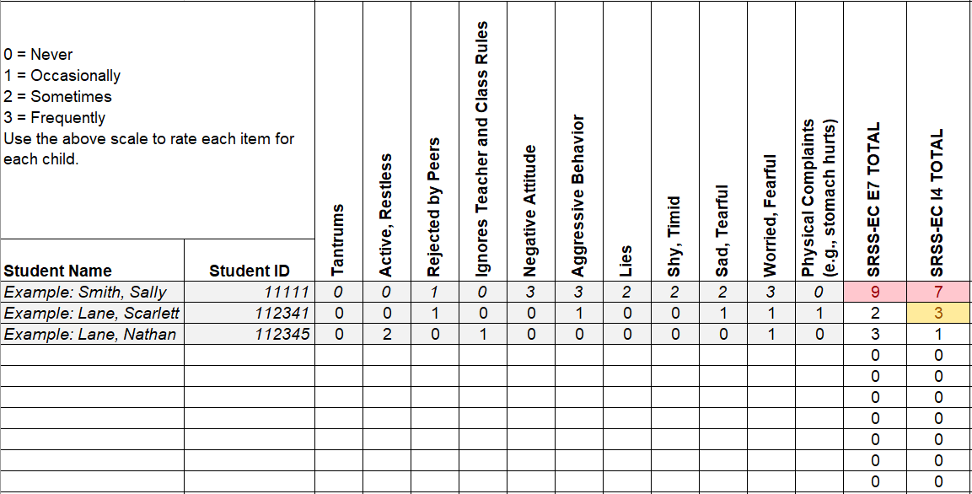
Student Risk Screening Scale for Early Childhood
(SRSS-EC; Lane & Menzies, 2009)

Slide 57
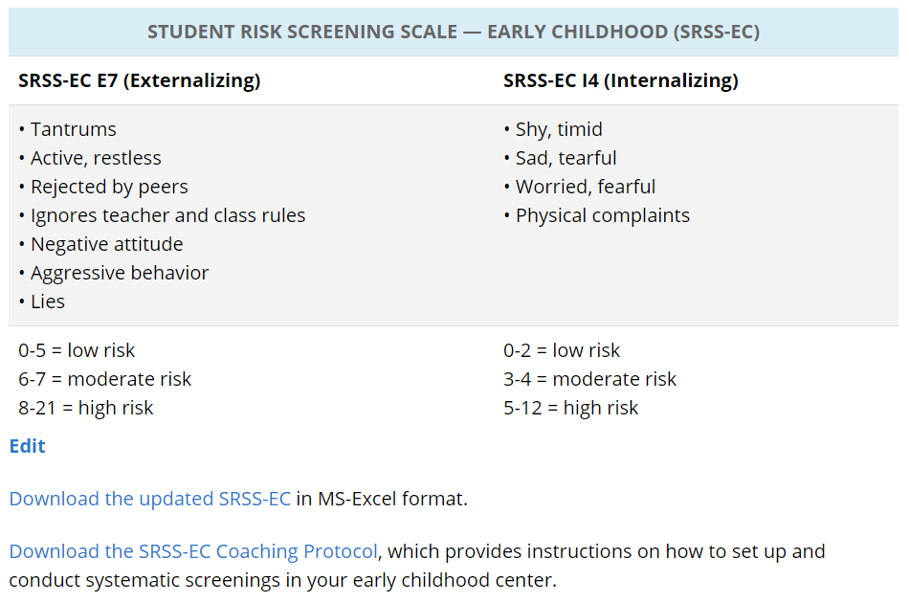

Slide 58
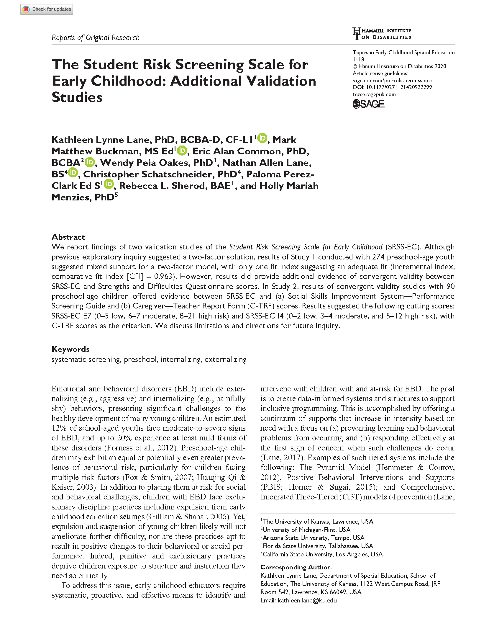
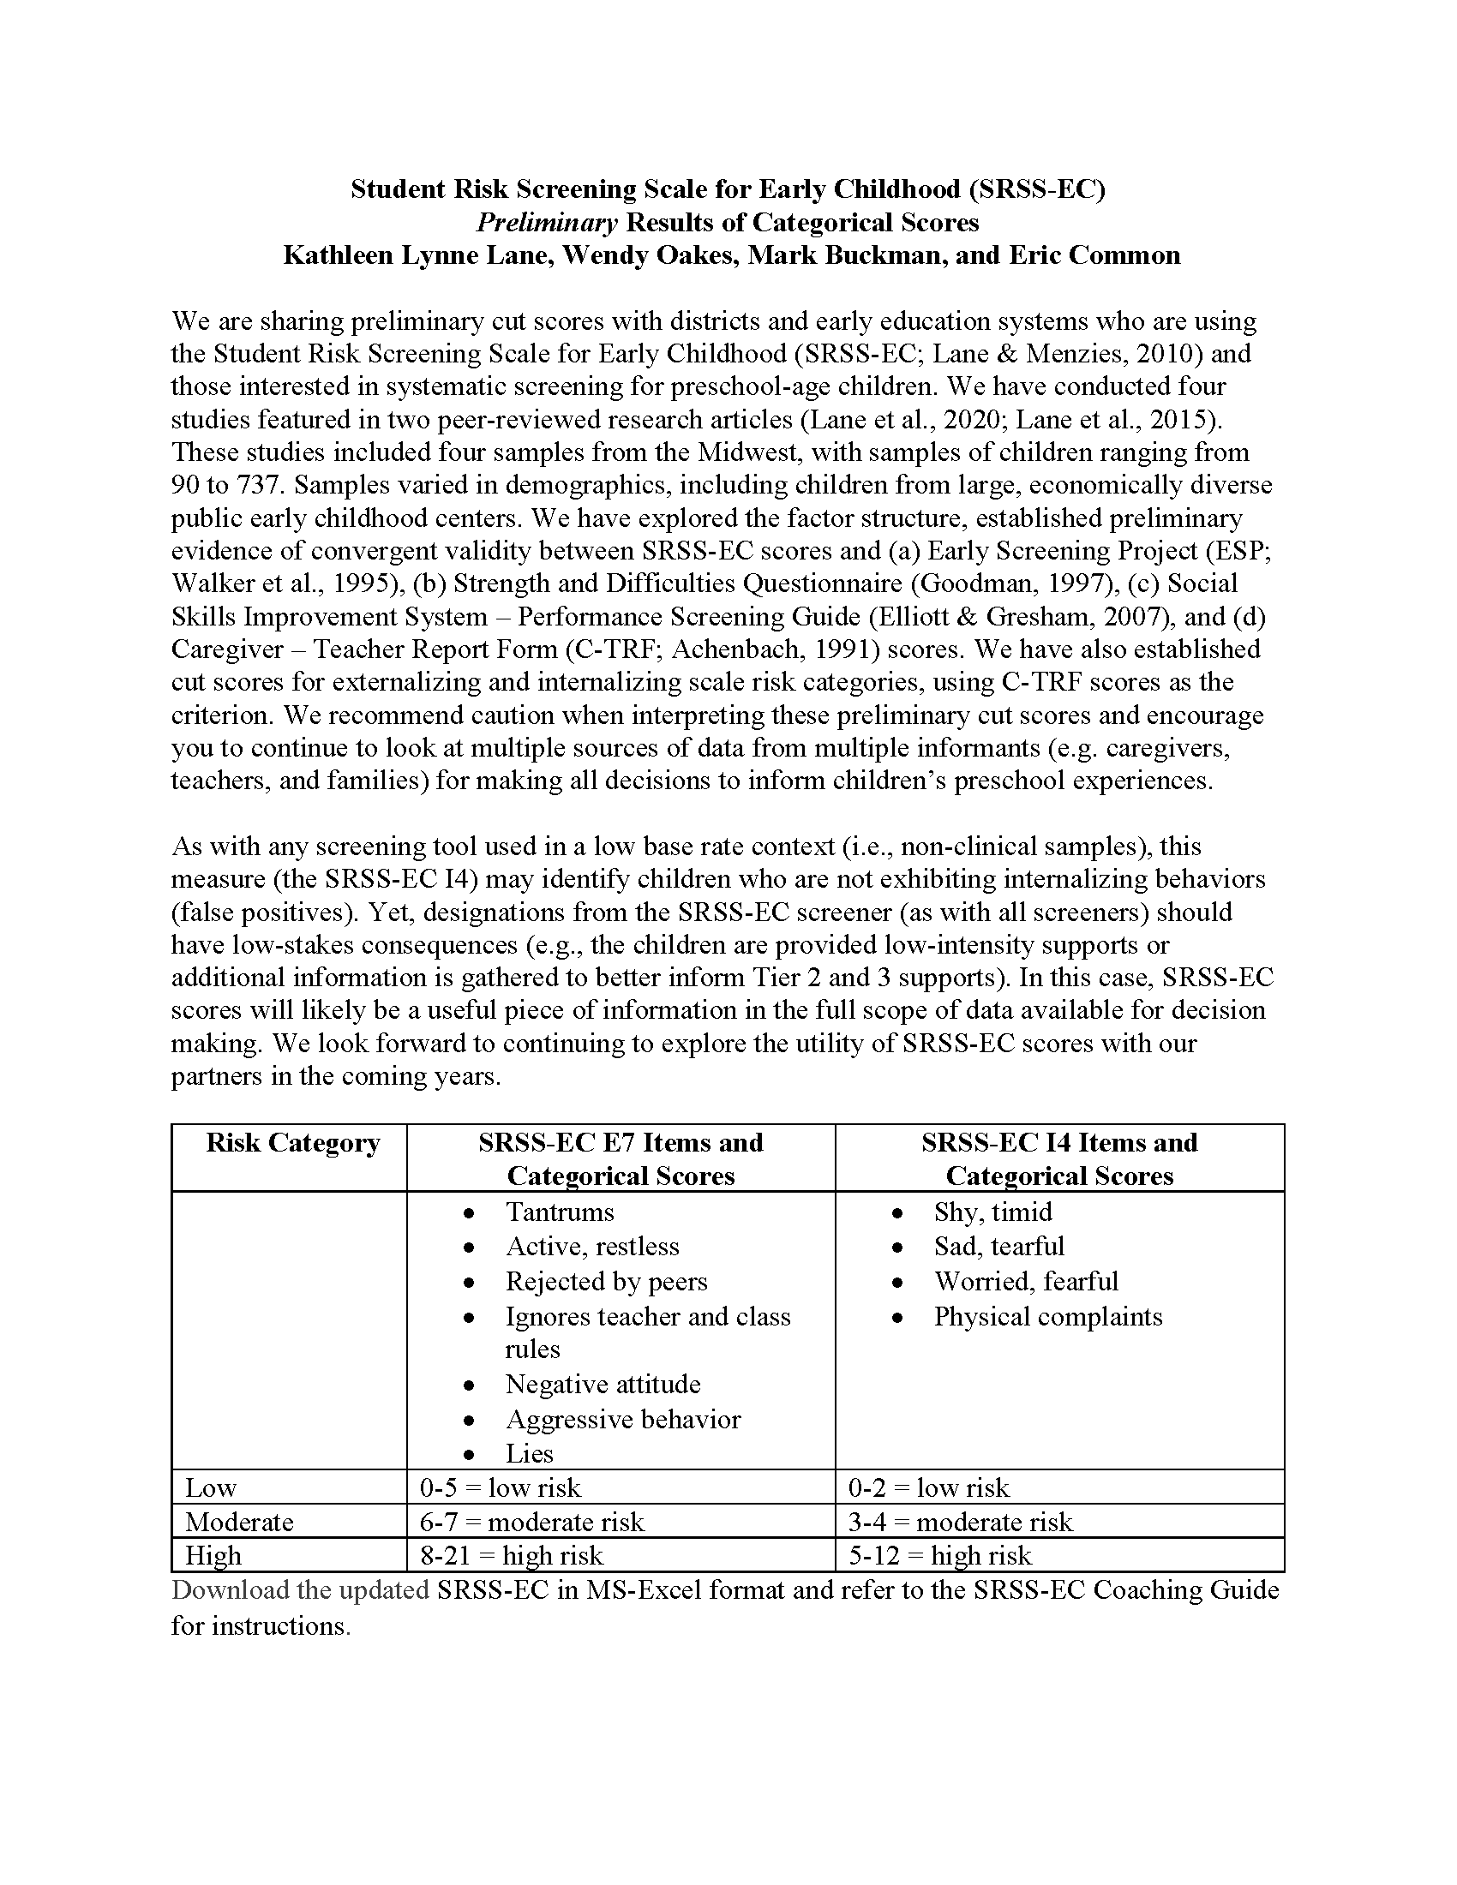
SRSS-EC: Initial Evidence
Research brief available on ci3t.org/screening

Slide 59
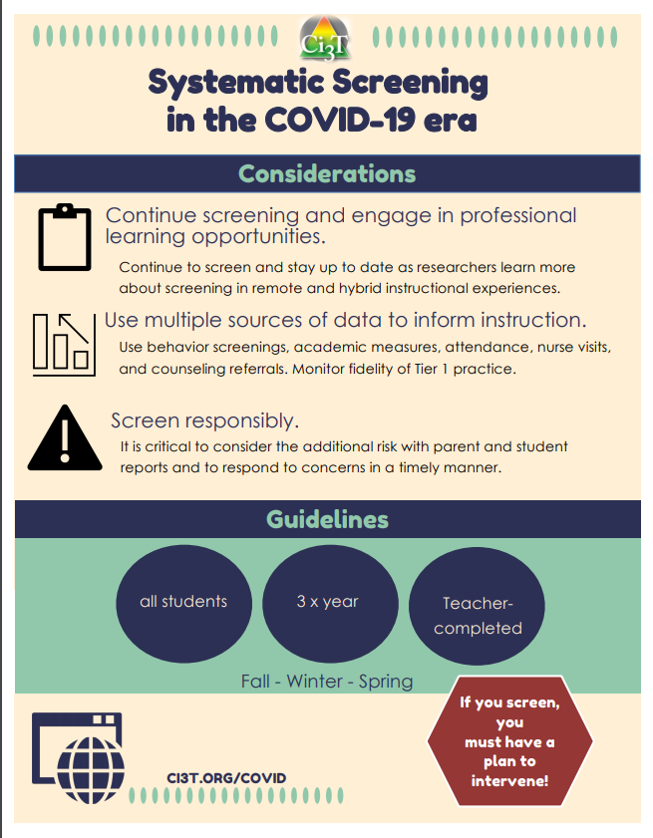
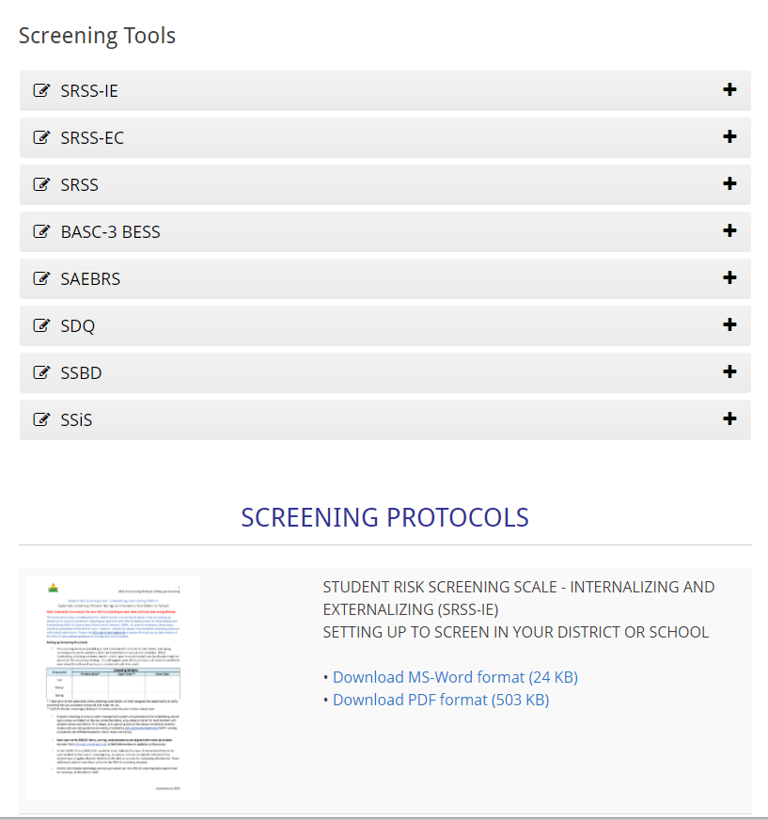

Slide 60
Project SCREEN

Slide 62
Data Sharing

Slide 63
Resources for screening available on PBIS.org…
Guidance for Systematic Screening: Lessons Learned from Practitioners
Selecting a Universal Behavior Screening Tool: Questions to consider

Slide 64
https://tinyurl.com/sharingscreening → pbis.org
Tips for District and School Leadership Teams
Create opportunities for community members to learn about the “why and how” of school wide systematic screening for behavior
Gather reliable information about systematic screening.
Inform community members before starting the school wide screening process.
Keep an open line of communication with community members.
Present information to the community.

Slide 65
Collecting screening data
ci3t.org/screening
Download Systematic Screening Protocol: Site-level Preparation Protocol
If you are already screening
Who leads screening at your school?
What questions come up when screening?
How might use of a protocol like this support consistent screening procedures?
If you are not screening in your school
What questions do you have?
Notes:
10-min timer

Slide 66
Agenda
Introducing Ci3T… a Comprehensive, Integrated, Three-Tiered Model of Prevention
The Role of Screening: Using Screening Data to Shape Instruction
At Tier 1: Primary Preventions Efforts
At all Tiers: Teacher-delivered Strategies
At Tiers 2 & 3: Secondary & Tertiary Prevention Efforts
Planning for Next Steps

Slide 67
Examining Academic and Behavioral Data
Lane, K. L., Menzies, H. M., Ennis, R. P., & Oakes, W. P. (2015). Supporting Behavior for School Success: A Step-by-Step Guide to Key Strategies. Guilford Press.
Notes:
Lane, K. L., Oakes, W. P., Ennis, R. P., & Hirsch, S. E. (2014). Identifying students for secondary and tertiary prevention efforts: How do we determine which students have Tier 2 and Tier 3 needs? Preventing School Failure, 58, 171-182, DOI: 10.1080/1045988X.2014.895573

Slide 68
tinyurl.com/screeningk12 → pbis.org
Using multiple sources of data
Academic
Systematic screening
GPA
Course failures
Common formative assessments
Behavioral
Systematic screening
Attendance
Office Discipline Referrals
Nurse visits
Social
Systematic screening
Nurse visits
Other referrals (e.g., counselor)

Slide 69
Notes:
Ci3T.org: On-demand Professional Learning Resources

Slide 70
Low-Intensity Strategies

Slide 71
ci3t.org
Professional Learning tab

Slide 73
www.ci3t.org/covid
Choice
Materials to support remote learning
Step-by-step Video
Step-by-step Checklist
Infographic

Slide 74
Integrated Lesson Planning

Slide 75
Low-Intensity Strategy | Franklin High School On-Site Expert
Behavior-Specific Praise: Identifying the specific expectation the student met. “Niama, I noticed you outlined your paper and used the graphic organizer to draft your essay. Well done!” “Justice, thank you for pushing in your chair to keep the walkway safe.” | Eric Common, Behavior Specialist Mark Buckman, Special Education Grant Allen, Parent Volunteer Paloma Pérez-Clark, School Psychologist
Opportunities to Respond: Providing 4-6 opportunities per minute for students to respond individually, choral, verbal, written, gesture, or symbol. “Show me thumbs or thumbs down if...” “Show me on your white board what…” “Turn to your elbow partner and say…” “All together now, what is…” | David Royer, Administration Emily Cantwell, 12th Grade Scarlett Lane, 11rd Grade Mallory Messenger, Counselor
Instructional Choice: Providing within-task or between task choices to increase academic engaged time and motivation. “Ronaldo, our of our 3 learning objectives today, which would you like to work on first?” “Suzy, do you want to work on the laptop, or handwrite your answers for this assignment?” | Abbie Jenkins, 10th Grade Scarlett Lane, 11th Grade José Sousa, PE Liane Johl, 9th Grade

Slide 76
Exploring Teacher-Delivered, Low-Intensity Supports …
Ci3T Professional Learning Tab
Schedule Time to Explore!
Notes:
15-min timer

Slide 77
Agenda
Introducing Ci3T… a Comprehensive, Integrated, Three-Tiered Model of Prevention
The Role of Screening: Using Screening Data to Shape Instruction
At Tier 1: Primary Preventions Efforts
At all Tiers: Teacher-delivered Strategies
At Tiers 2 & 3: Secondary & Tertiary Prevention Efforts
Planning for Next Steps

Slide 78
Comprehensive, Integrated, Three-Tiered Model of Prevention
(Lane, Kalberg, & Menzies, 2009)
Tier 3
Tertiary Prevention (≈5%)
Tier 2
Secondary Prevention (≈15%)
Secondary (Tier 2) Intervention Grids
Tier 1
Primary Prevention (≈80%)
Academic ◇ Behavioral ◇ Social
Validated Curricula PBIS Framework Validated Curricula

Slide 81
An illustration
Support | Description | Schoolwide Data: Entry Criteria | Data to Monitor Progress: | Exit Criteria
Small group reading instruction with self-monitoring | Small group reading instruction (30 min, 3 days per week). Students monitored their participation in the reading instructional tasks. Students used checklists of reading lesson components each day to complete and compare to teachers’ rating. K – 1. | Students who: Behavior: Fall SRSS at moderate (4 -8) or high (9 – 21) risk Academic: Fall AIMSweb LNF at the strategic or intensive level | AIMSweb reading PSF and NWF progress monitoring probes (weekly). Daily self-monitoring checklists Treatment Integrity Social Validity | Meet AIMSweb reading benchmark at next screening time point. Low Risk on SRSS at next screening time point.

Slide 82
First Grade Students’ Self Monitoring Form
Altmann, S. A. (2010). Project support and include: the additive benefits of self-monitoring on students’ reading acquisition. Unpublished master’s thesis, Vanderbilt University.

Slide 83
Treatment Integrity Social Validity Monitor student progress
Altmann, S. A. (2010). Project support and include: the additive benefits of self-monitoring on students’ reading acquisition. Unpublished master’s thesis, Vanderbilt University.

Slide 84
Sample Elementary Intervention Grid: SSiS
Support | Description | School-wide Data: Entry Criteria | Data to Monitor Progress | Exit Criteria
Social Skills Improvement System (SSiS) – counselor-led small group | Counselors and/or social workers will lead small group SSiS sessions for approximately 30-40 min 2-3 days per week. Students will acquire new skills, learn how to engage more fully in instructional experiences, and learn how to meet more school-wide expectations. Small groups will run for up to 24 sessions (8 to 12 weeks depending on the number of sessions conducted per week) using a subset of SSiS lessons appropriate for student skillsets as identified using SSiS-Rating Scale (teacher and parent version). | Behavior SRSS-E7 score: Moderate (4-8) and/or SRSS-I5 score: Moderate (2-3) AND 2 or fewer absences in first 3 months of school AND Evidence of teacher implementation of Ci3T primary (Tier 1) plan [treatment integrity: direct observation] AND Parent permission AND Academic Student is in grade 2 or 3 | Student measures SSiS-Rating Scale (Pre/Post) Skills for Greatness (Pre/Post) Daily behavior report (DBR; daily) Attendance and tardies Social validity Teacher: IRP-15 Student: CIRP Treatment integrity Tier 2 treatment integrity measures Ci3T TI: Direct observation (30 min if needed) | Review student progress at end of 24 sessions Team agrees goals have been met or no further SSiS small group sessions are warranted SRSS-E7 and I5 scores are in the low risk category

Slide 85
Active Supervision
https://eclkc.ohs.acf.hhs.gov/safety-practices

Slide 86
Support | Description | Schoolwide Data: Entry Criteria | Data to Monitor Progress: | Exit Criteria
READ 180 (Stage C) Reading Intervention | Students participate in a 50 min reading instructional block during their study hall period. Students meet in the computer lab for participation in the online portion 20 min daily. Instruction is relevant to high school students. Students use a progress management system to monitor and track their own progress. Instruction is taught by special education teachers and general education teachers with training in the READ 180 Curriculum. | (1) Students in grades 9 – 12. (2) Reading performance basic or below basic on state assessment (but above 4th grade reading level). (3) SRSS risk scores in the moderate range (4 – 8). | Student Measures: Meeting individual READ 180 reading goals: (1) Progress Monitoring with Scholastic Reading Inventory (2) Writing Assessments (3) formative assessments (vocabulary, comprehension and spelling) (4) Curriculum-based Assessments (5) Attendance in class Treatment Integrity: Teachers monitor performance and attendance in class. Completion of weekly checklists for activities completed. Social Validity: Students and teachers complete surveys | Students meet instructional reading goals. SRSS score in the low risk category (0 – 3) on the next screening time point.
Lane, K. L., Oakes, W. P., Menzies, H. M., Oyer, J., & Jenkins, A. (2013). Working within the context of three-tiered models of prevention: Using school wide data to identify high school students for targeted supports. Journal of Applied School Psychology, 29, 203-229.

Slide 87
Support | Description | Schoolwide Data: Entry Criteria | Data to Monitor Progress: | Exit Criteria
Targeted Algebra II Study Hall | Direct, targeted instruction of Algebra II learning targets by math teachers. Time will be used to re-teach concepts, provide one-on-one or small group instruction and offer greater supports for students struggling to pass the graduation requirement course. 50 min per day until exit criteria is met. | (1) 12th graders (2) Algebra II grade drops below a 75 at any point in the semester (3) Have study hall time available and permission of 5th period teacher (4) Self-selecting to engage in study hall | Student Measures: Algebra II classroom grades Daily class average if grade is ≤ 75 Treatment Integrity: Daily monitoring of the lessons covered and student attendance Social Validity: Pre and Post Student Surveys | Algebra II Grade increases to satisfactory level (above 75%).
Lane, K. L., Oakes, W. P., Menzies, H. M., Oyer, J., & Jenkins, A. (2013). Working within the context of three-tiered models of prevention: Using school wide data to identify high school students for targeted supports. Journal of Applied School Psychology, 29, 203-229.

Slide 88
Comprehensive, Integrated, Three-Tiered Model of Prevention
(Lane, Kalberg, & Menzies, 2009)
Tier 3
Tertiary Prevention (≈5%)
Tier 2
Secondary Prevention (≈15%)
Tertiary (Tier 3) Intervention Grids
Tier 1
Primary Prevention (≈80%)
Academic ◇ Behavioral ◇ Social
Validated Curricula PBIS Framework Validated Curricula

Slide 90
Collecting screening data
tinyurl.com/sharingscreening
If you are currently screening in your school
Do you have access to your students’ data?
How do you use data to inform instruction?
How (and with who) do you share the data?
What are some opportunities for growth?
If you are not screening in your school
What questions do you have?
Notes:
10-min timer

Slide 91
Agenda
Introducing Ci3T … a Comprehensive, Integrated, Three-Tiered Model of Prevention
The Role of Screening: Using Screening Data to Shape Instruction
At Tier 1: Primary Preventions Efforts
At all Tiers: Teacher-delivered Strategies
At Tiers 2 & 3: Secondary & Tertiary Prevention Efforts
Planning for Next Steps

Slide 92
Ci3T: Monitoring for Success: Using Data to Inform Instruction
… Action Planning

Slide 94
Ci3T Monthly Leadership Team Meetings

Slide 95
Ci3T EMPOWER Sessions Location: Remote via Zoom Attended by: School Ci3T Leadership Teams Ci3T District Trainers and Coaches Faculty and Staff Families (adults only) Community Members |  | Times CST All Times Tentative
How do we set up for Success? Using Your Ci3T Structures | September 22, 2021 | 5:00 p.m. – 7:00 p.m.
You’ve Got This! Using Your Ci3T Structures to Support Positive Behavior | November 10, 2021 | 5:00 p.m. – 7:00 p.m.
What Do I Need to Know About Screening? | January 13, 2022 | 5:00 p.m. – 7:00 p.m.
Where did that come from? Understanding and Managing Acting Out Behavior | February 17, 2022 | 5:00 p.m. – 7:00 p.m.
How do I support students who are feeling anxious? Practical Strategies that Work | April 19, 2022 | 5:00 p.m. – 7:00 p.m.

Slide 96
Ci3T Trainers & Coaches Calls Location: *Held Remotely Attended by: Ci3T Trainers, Coaches, or Leadership Team Members; open to interested parties Zoom link: https://kansas.zoom.us/j/92361953100 |  | Times CST
Ci3T Trainers and Coaches Call 1 | August 05, 2021 | 4:00 p.m. – 5:00 p.m.
Ci3T Trainers and Coaches Call 2 | September 02, 2021 | 4:00 p.m. – 5:00 p.m.
Ci3T Trainers and Coaches Call 3 | October 19, 2021 | 4:00 p.m. – 5:00 p.m.
Ci3T Trainers and Coaches Call 4 | November 17, 2021 | 4:00 p.m. – 5:00 p.m.
Ci3T Trainers and Coaches Call 5 | December 14, 2021 | 4:00 p.m. – 5:00 p.m.
Ci3T Trainers and Coaches Call 6 | January 20, 2022 | 4:00 p.m. – 5:00 p.m.
Ci3T Trainers and Coaches Call 7 | February 22, 2022 | 4:00 p.m. – 5:00 p.m.
Ci3T Trainers and Coaches Call 8 | March 24, 2022 | 4:00 p.m. – 5:00 p.m.
Ci3T Trainers and Coaches Call 9 | April 12, 2022 | 4:00 p.m. – 5:00 p.m.
Ci3T Trainers and Coaches Call 10 | May 04, 2022 | 4:00 p.m. – 5:00 p.m.
Ci3T Trainers and Coaches Call 11 | June 02, 2022 | 4:00 p.m. – 5:00 p.m.

Slide 97
Thank you!

